Slide 1


Python for Everybody: A Truly Open MOOC
Dr. Charles Severance
University of Michigan School of Information
Notes:
Alternate thank you page

Slide 2
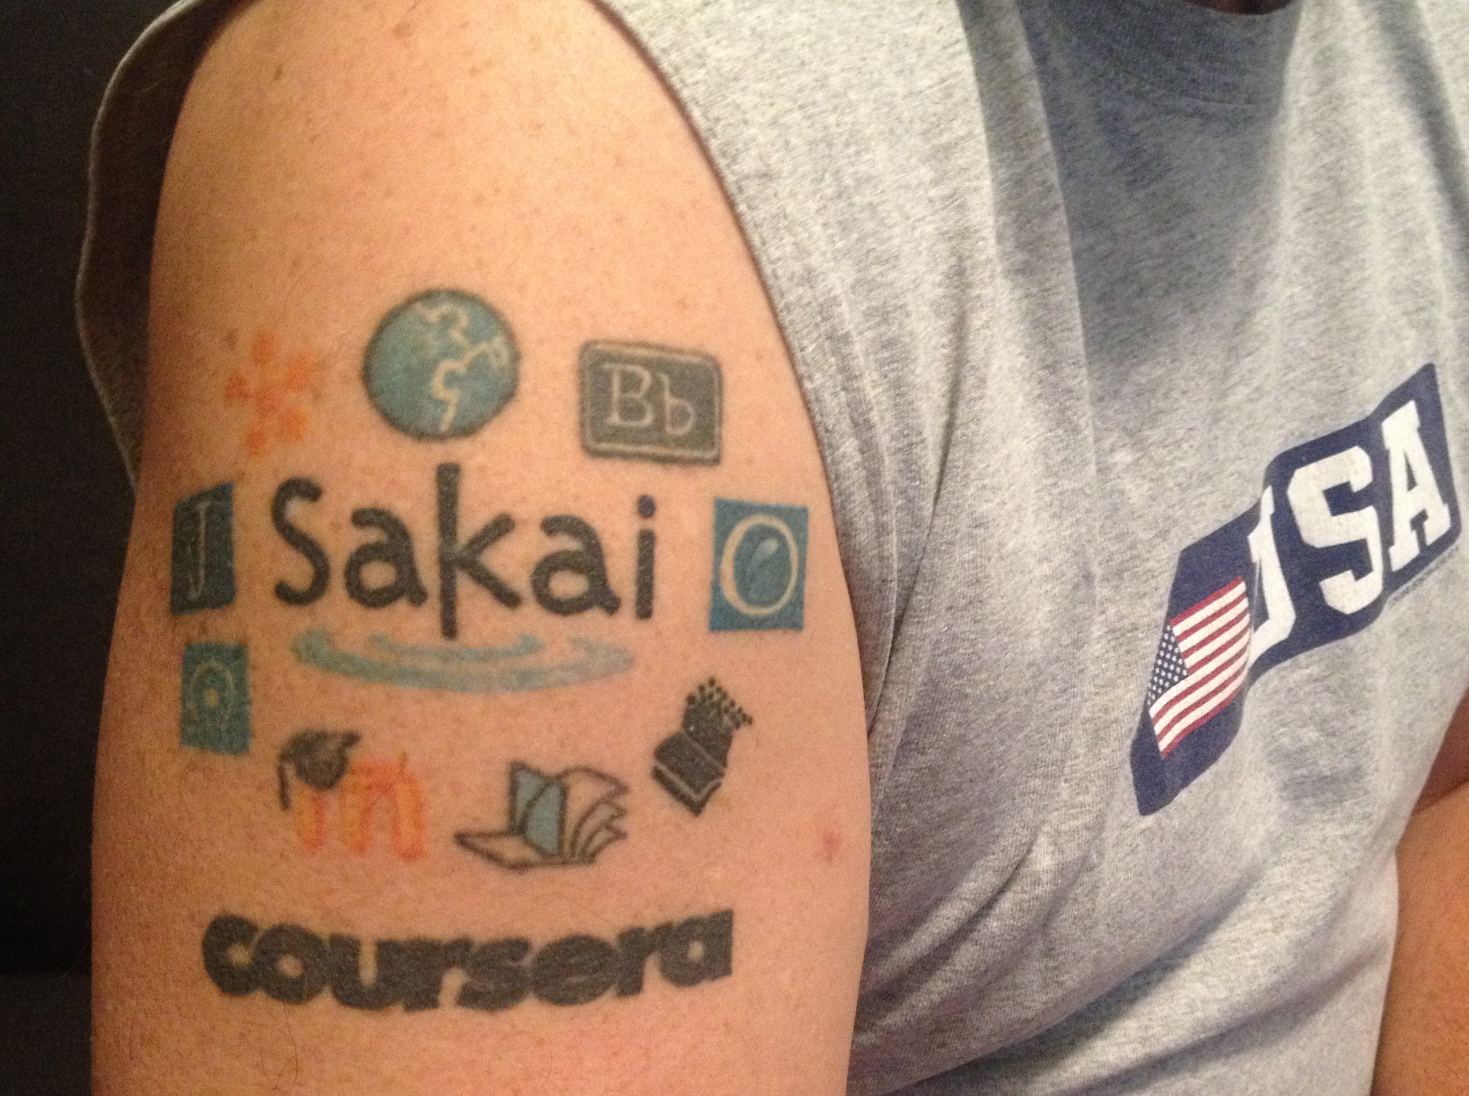
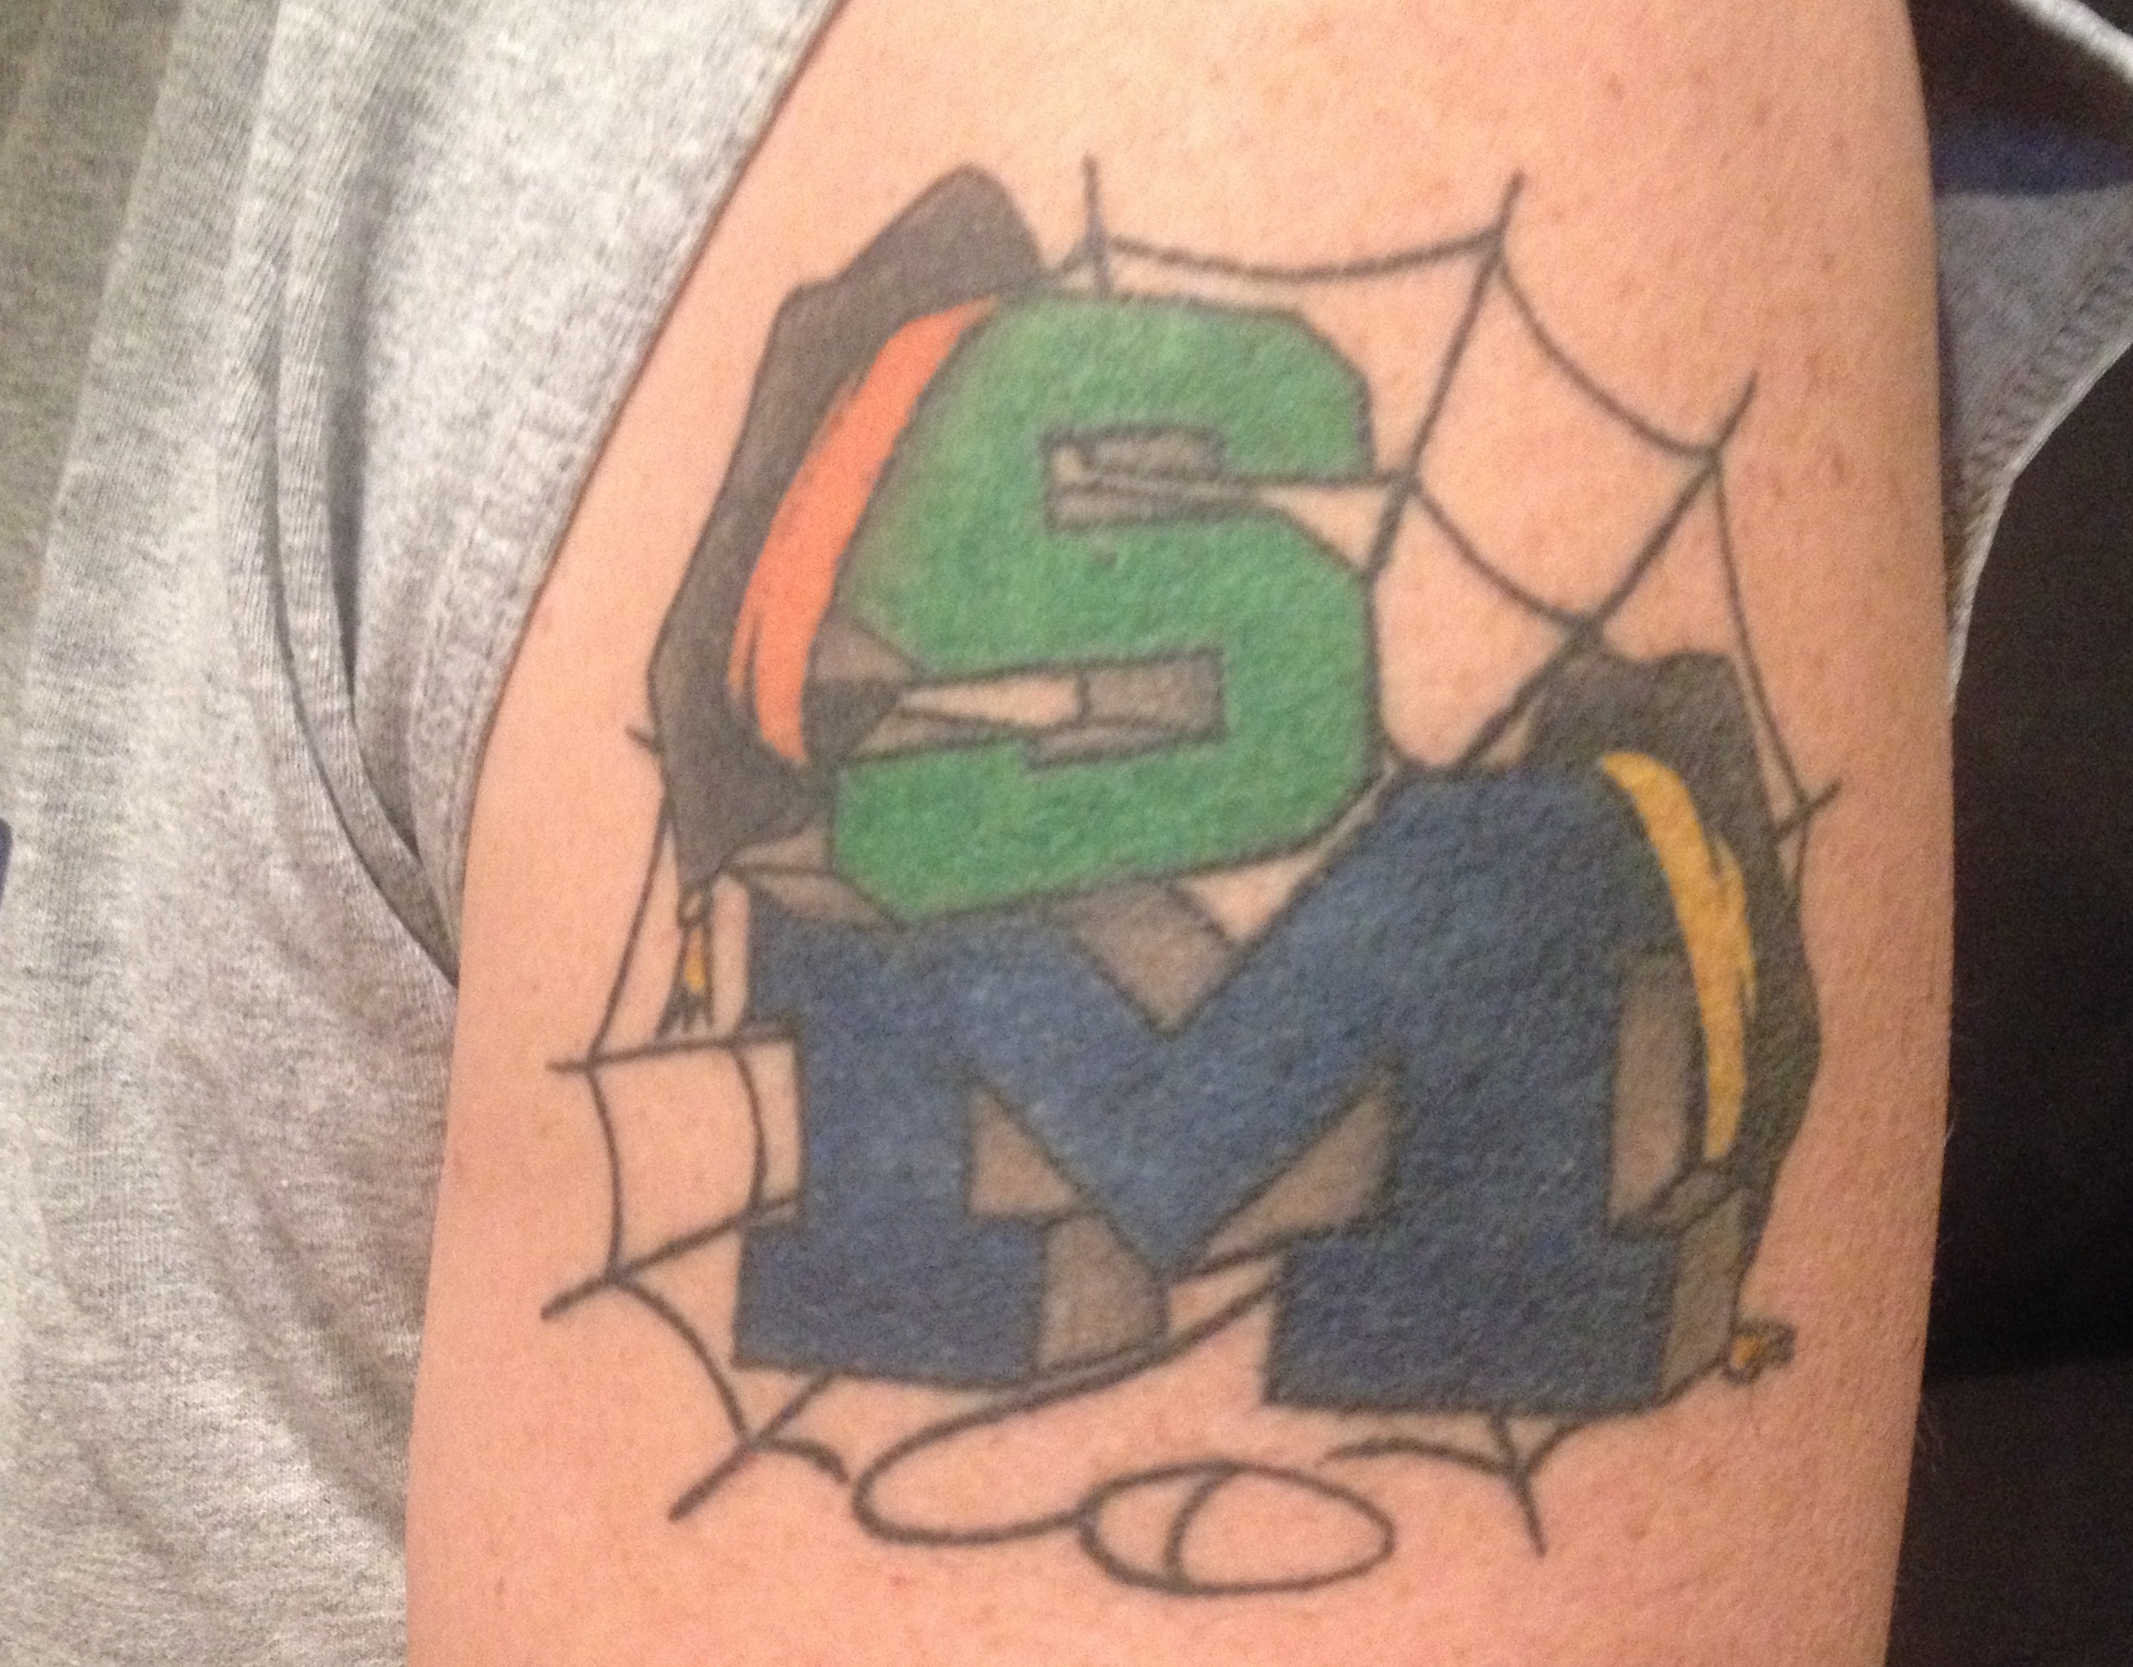

Slide 3
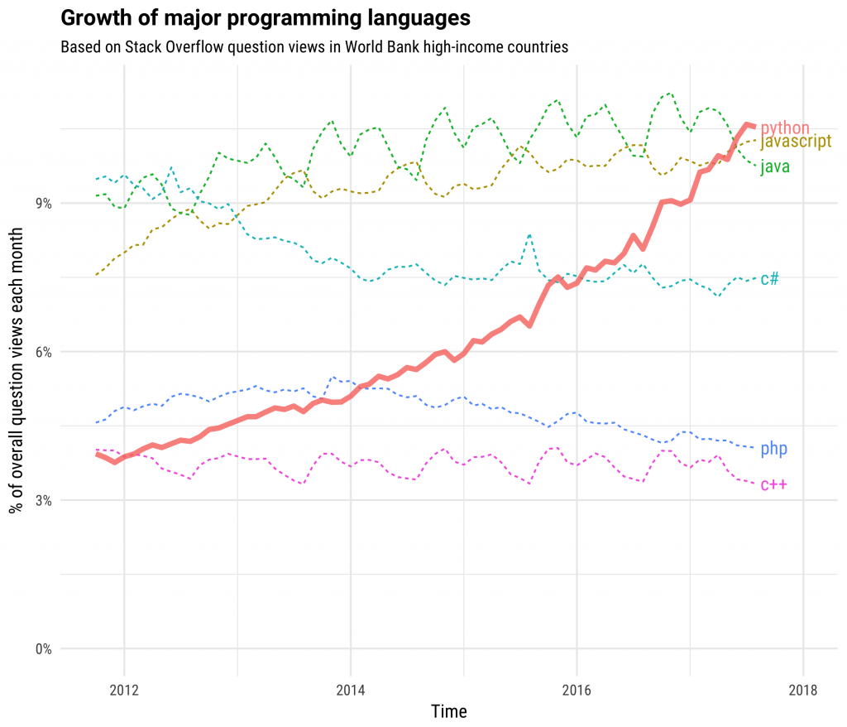
https://stackoverflow.blog/2017/09/06/incredible-growth-python/

Slide 5
Advantage: Python
The core of Python is small and easy to understand
Python is easily expanded using C when performance is critical
Python absorbs applications and turns them into libraries
Python loves orchestration
Statistics
Computation
AI / ML
Data Mining
Web Apps
????

Slide 6
What is a MOOC?
Circa 2012: Massively, Open, Online, Course
Circa 2018
Scalable from 500 to 100K+ students without greatly increasing costs
Open Admission – Might charge fee of less than $100
Online
Four week unit (about 1 credit)
Providers
www.coursera.org
www.edx.org
www.futurelearn.org
www.udacity.com
www.udemy.com

Slide 7
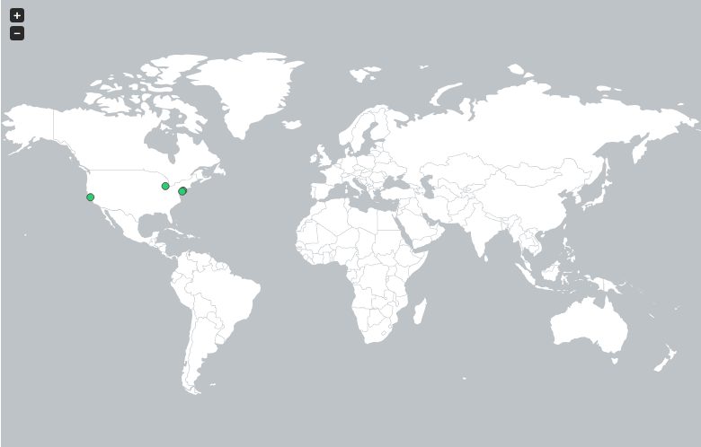
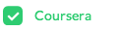
http://edutechnica.com/moocmap/
April 2012
Notes:
But let me take you back 18 short months when there was only one provider of MOOCs with only four Universities (University of Pennsylvania, Stanford, Michigan, and Princeton). It was just an experiment in early 2012 and I was fortunate to even know about the emerging effort – let alone be given a chance to teach this new type of course for the University of Michigan.

Slide 8
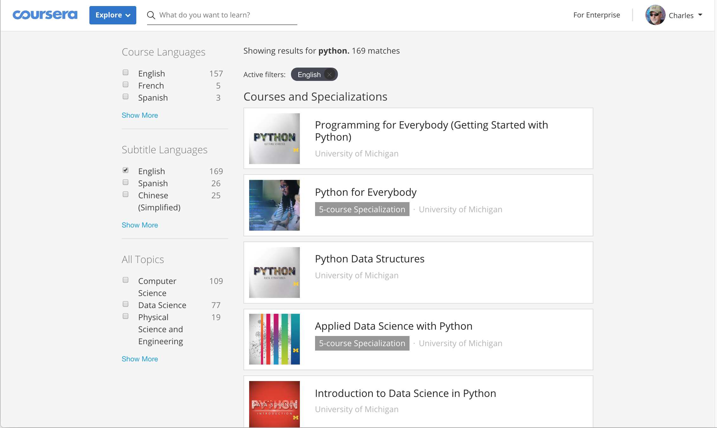

Slide 9
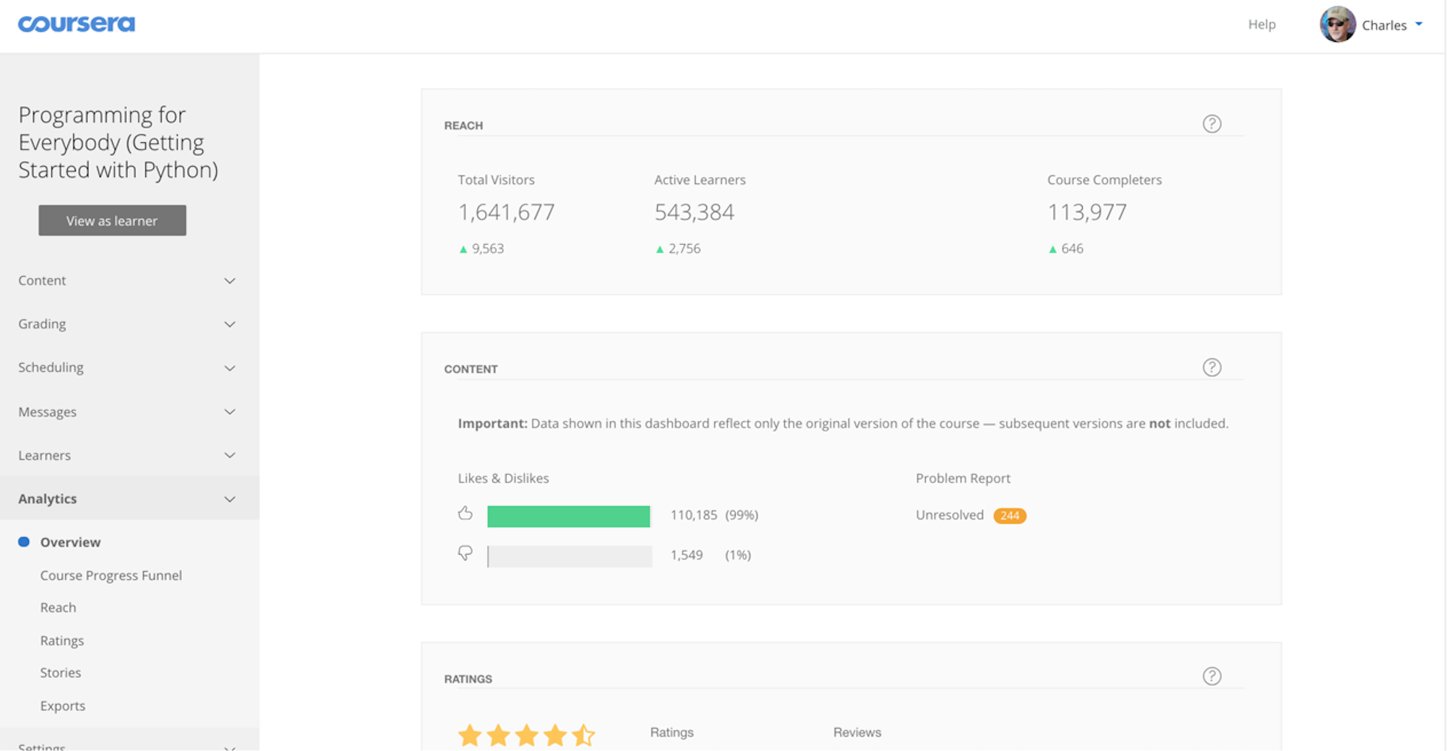
Plus 550K students from an earlier Python 2 MOOC.

Slide 10
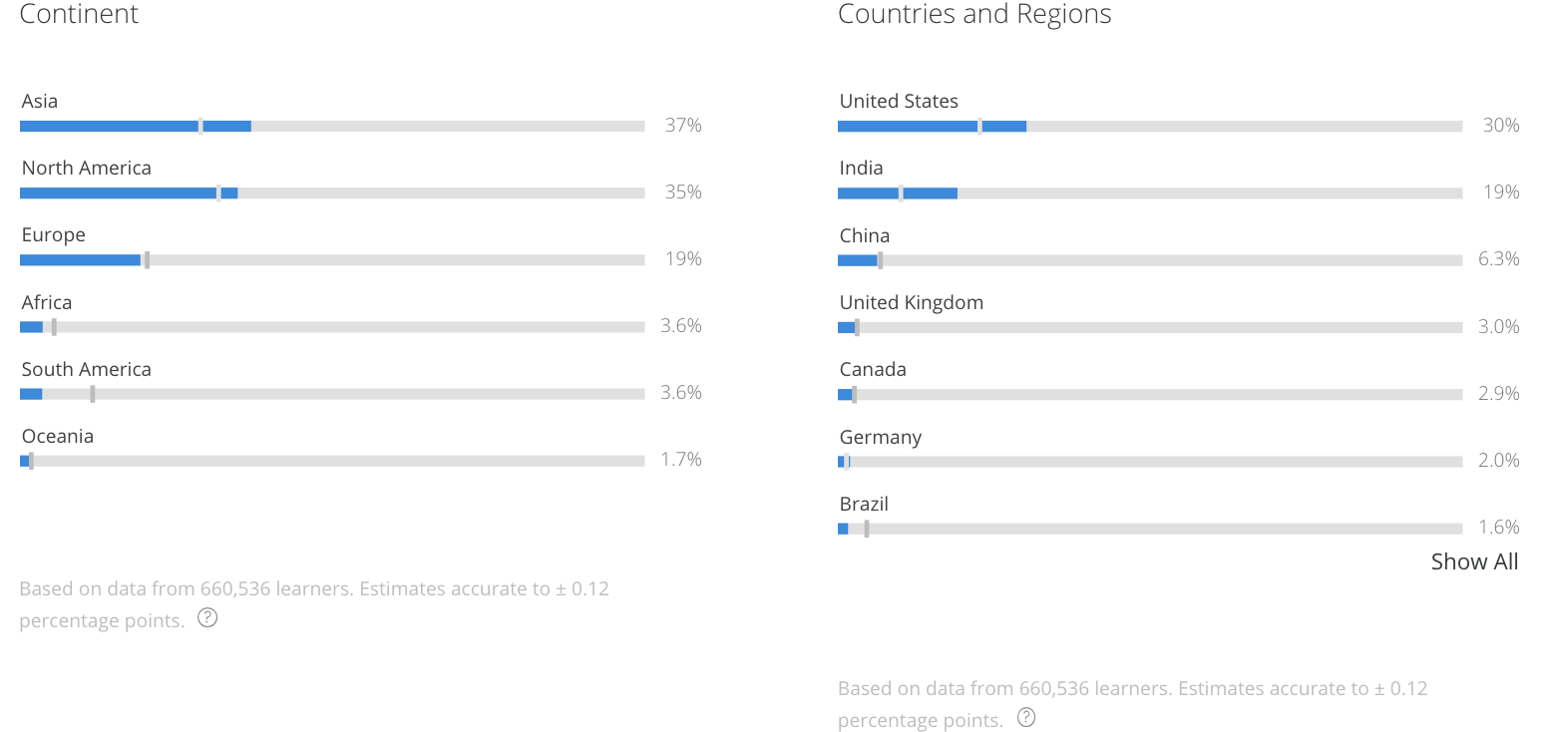

Slide 11
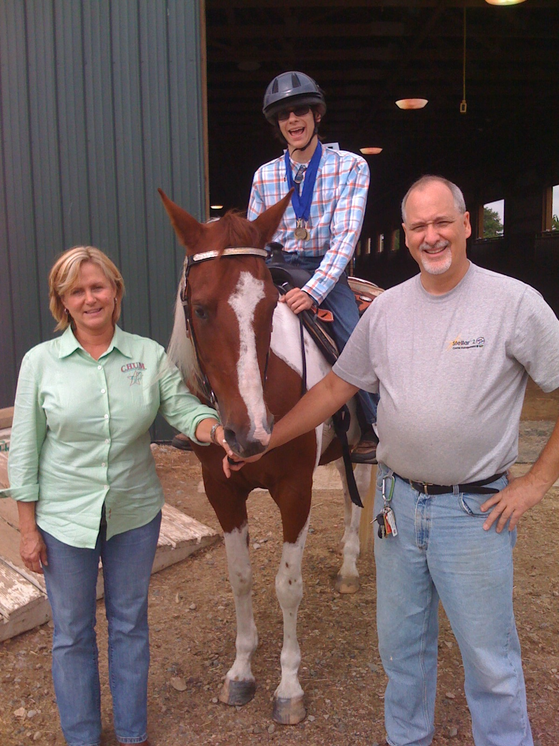

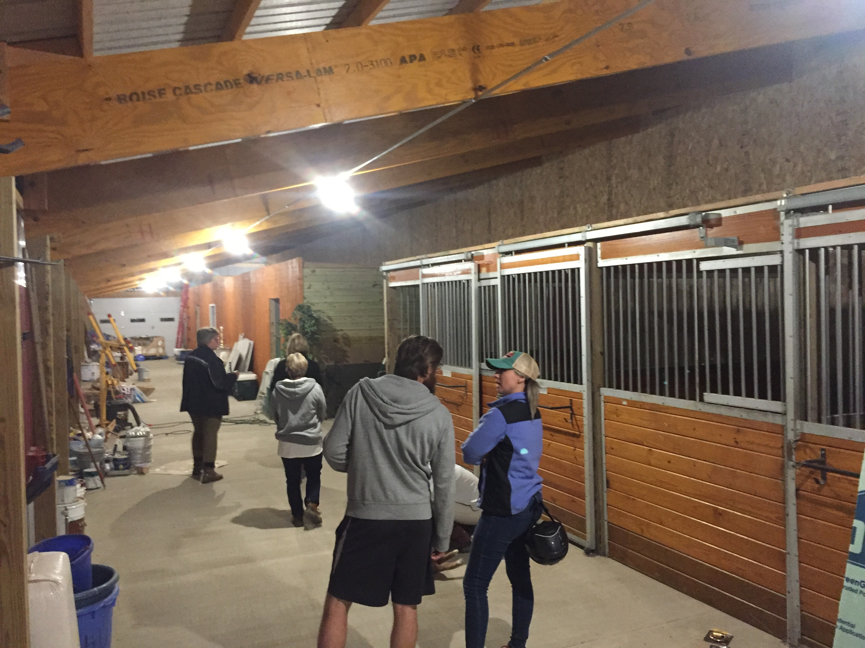


Slide 12



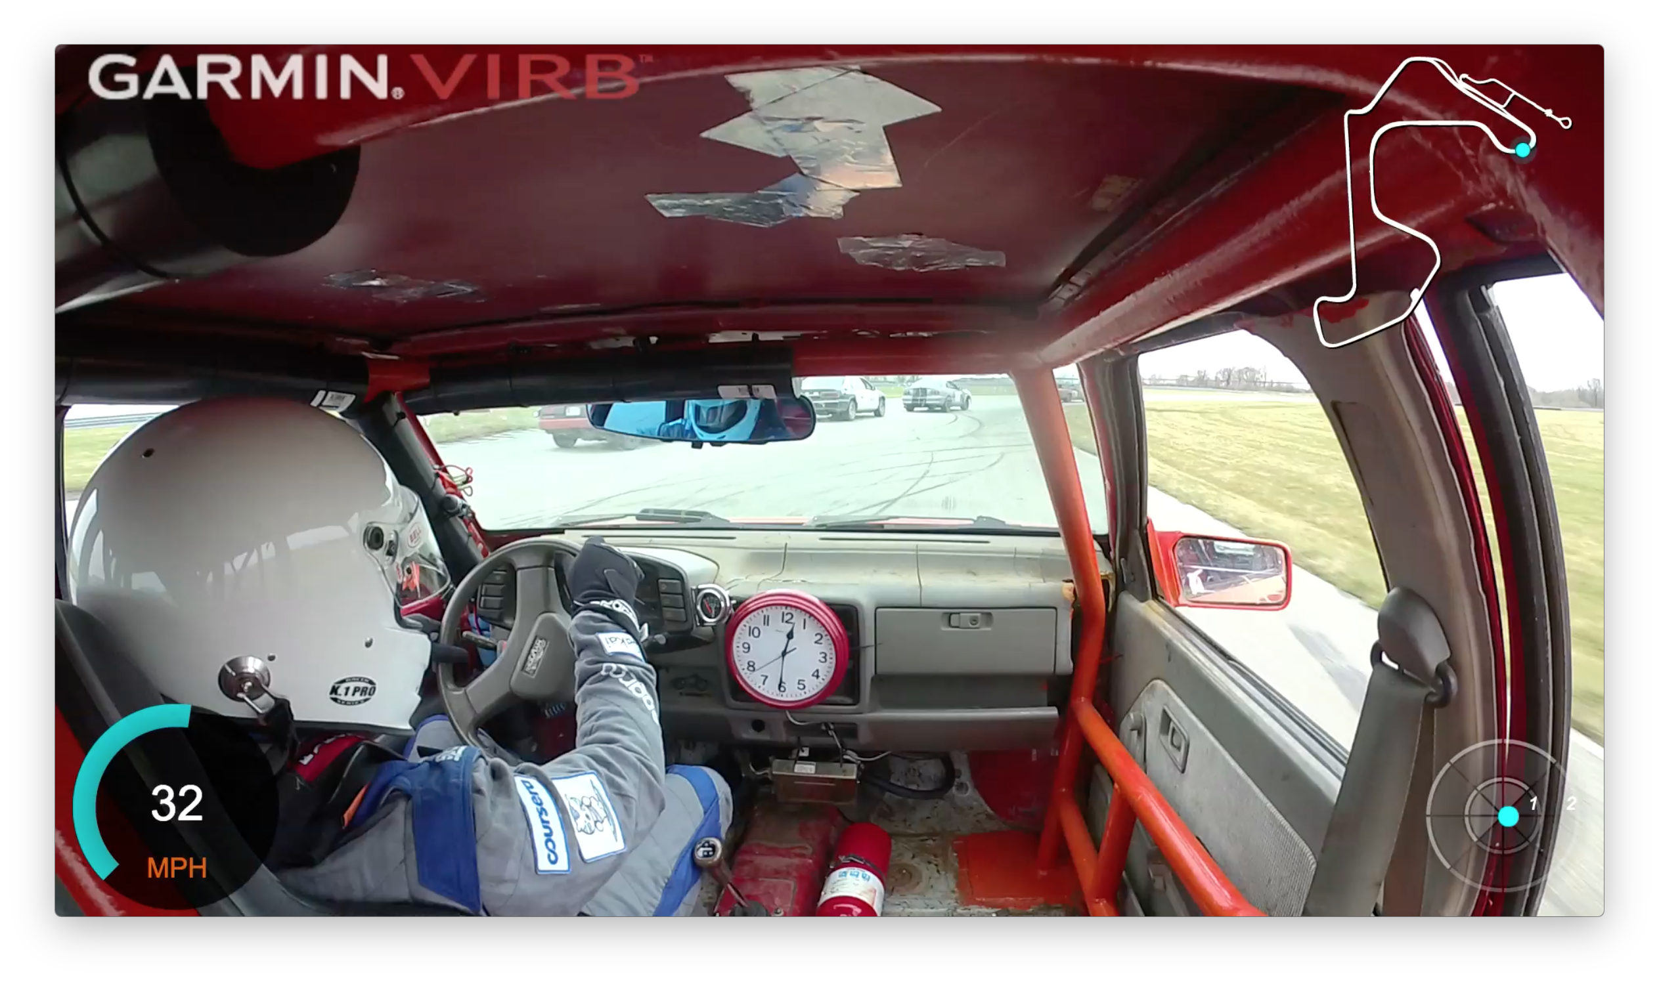
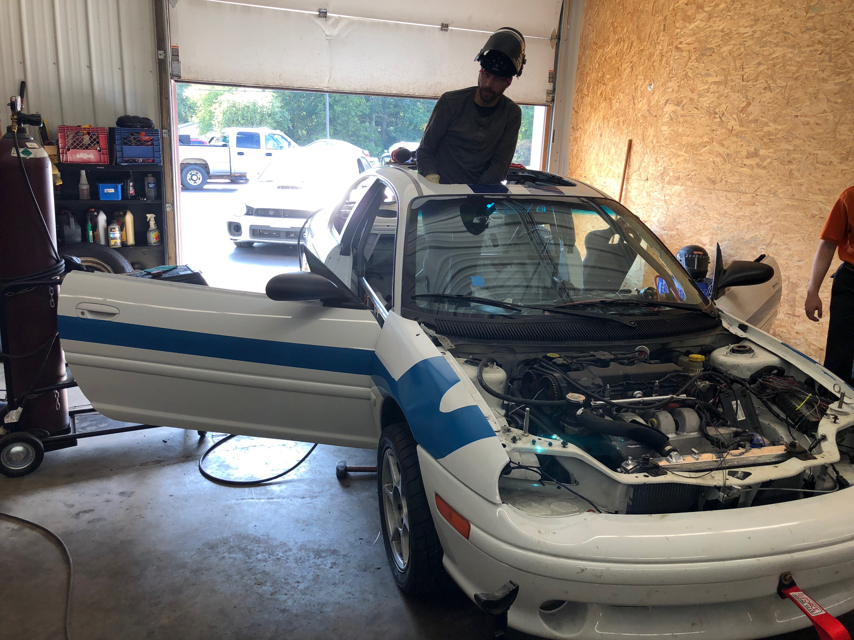

www.twitter.com/sakaicar
www.sakaiger.com
www.24hoursoflemons.com

Slide 13
My Research: Educational Technology

Slide 14
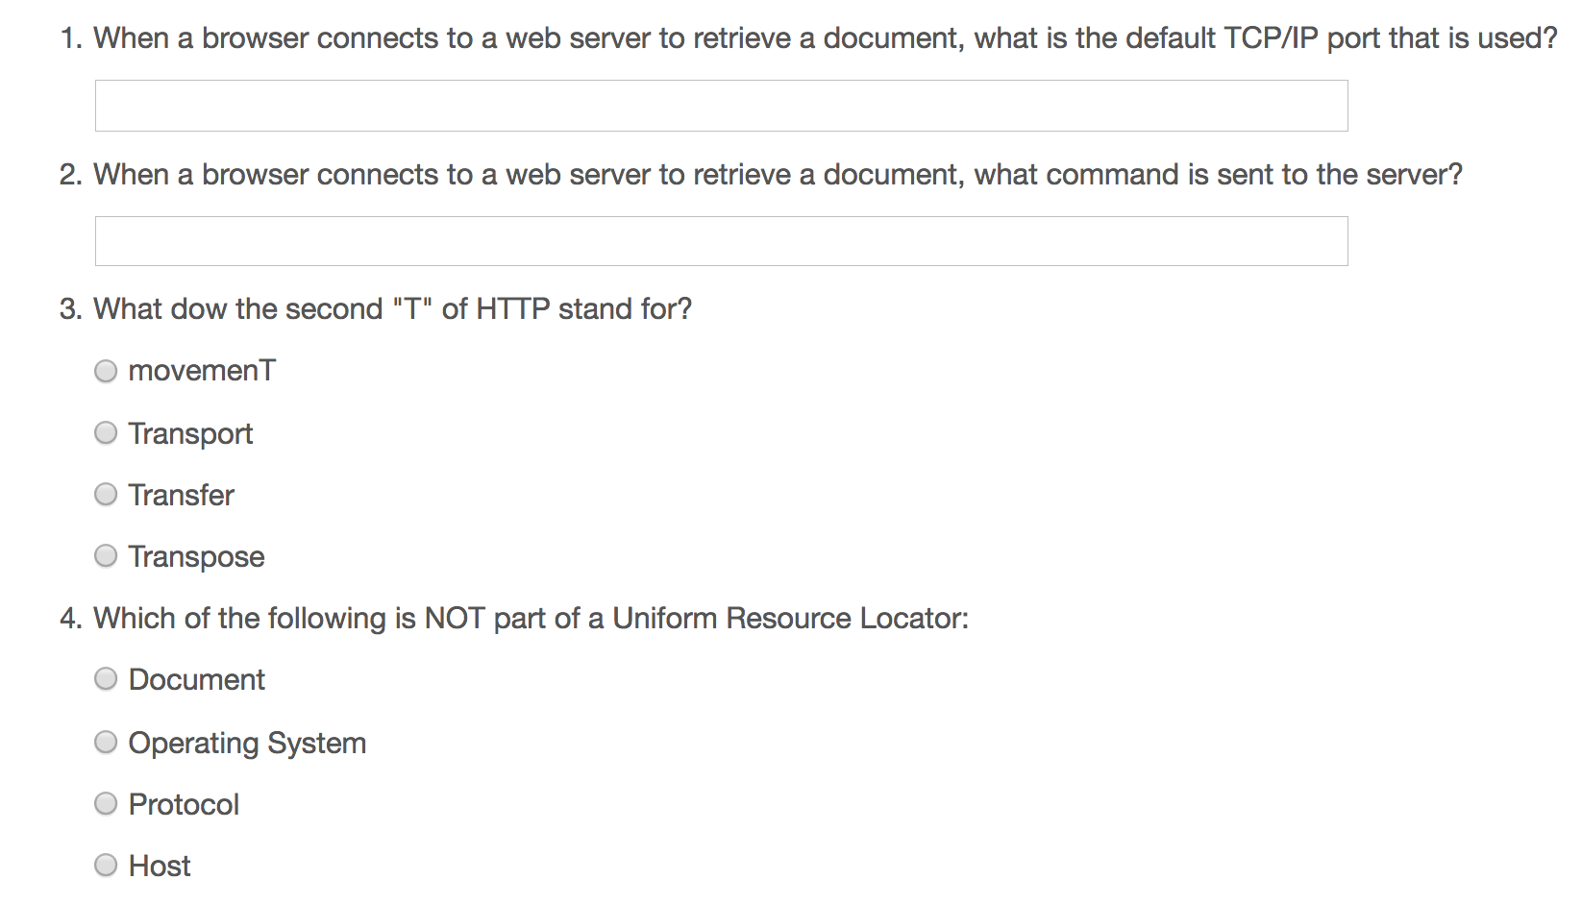
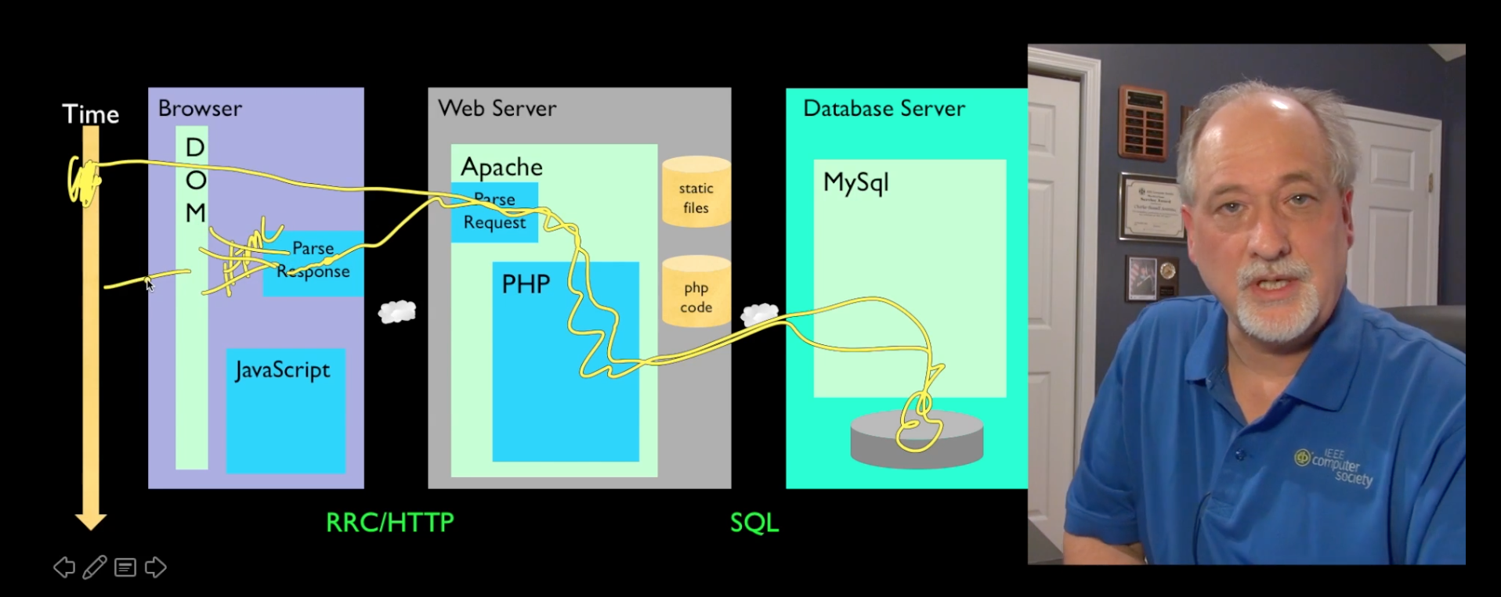
A Typical Scalable Online Class
Record Lectures
Build quizzes
Maybe use peer grading

Slide 15
My Path to a Scalable Online Course
Build Lecture Capture software (Sync-O-Matic) 1997
Build Lecture Capture Software (Clipboard-2000) 2001
Build an open source Learning Management System (LMS) (Sakai) (2004)
Build a standard for LMS interoperability / convince the mainstream systems to implement (2008)
Write a free textbook / upgrade that textbook / translate the textbook (2008)
Build open source software framework to build learning tools (Tsugi) (2011)
Build clever / puzzle based assessment software in the framework (2012)
Integrate those assessments in on campus courses
Build my own social / peer graded assessment software (2013)
Help Coursera write code to integrate my assessments (2014)
Build an open source small, standalone MOOC Platform to host those tools (Koseu) (2016)
Release all materials for free under Creative Commons / Apache (www.py4e.com)
Record lectures
Build courses with quizzes + engaging assessments
Build a learning community and mentor / empower / support its leaders
Turn the course into a "television" show / YouTube channel

Slide 16
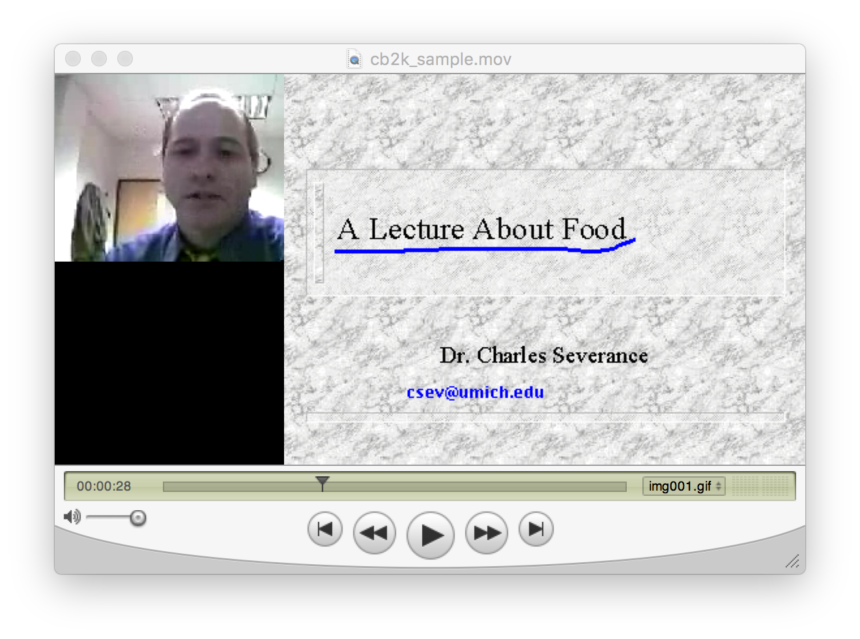
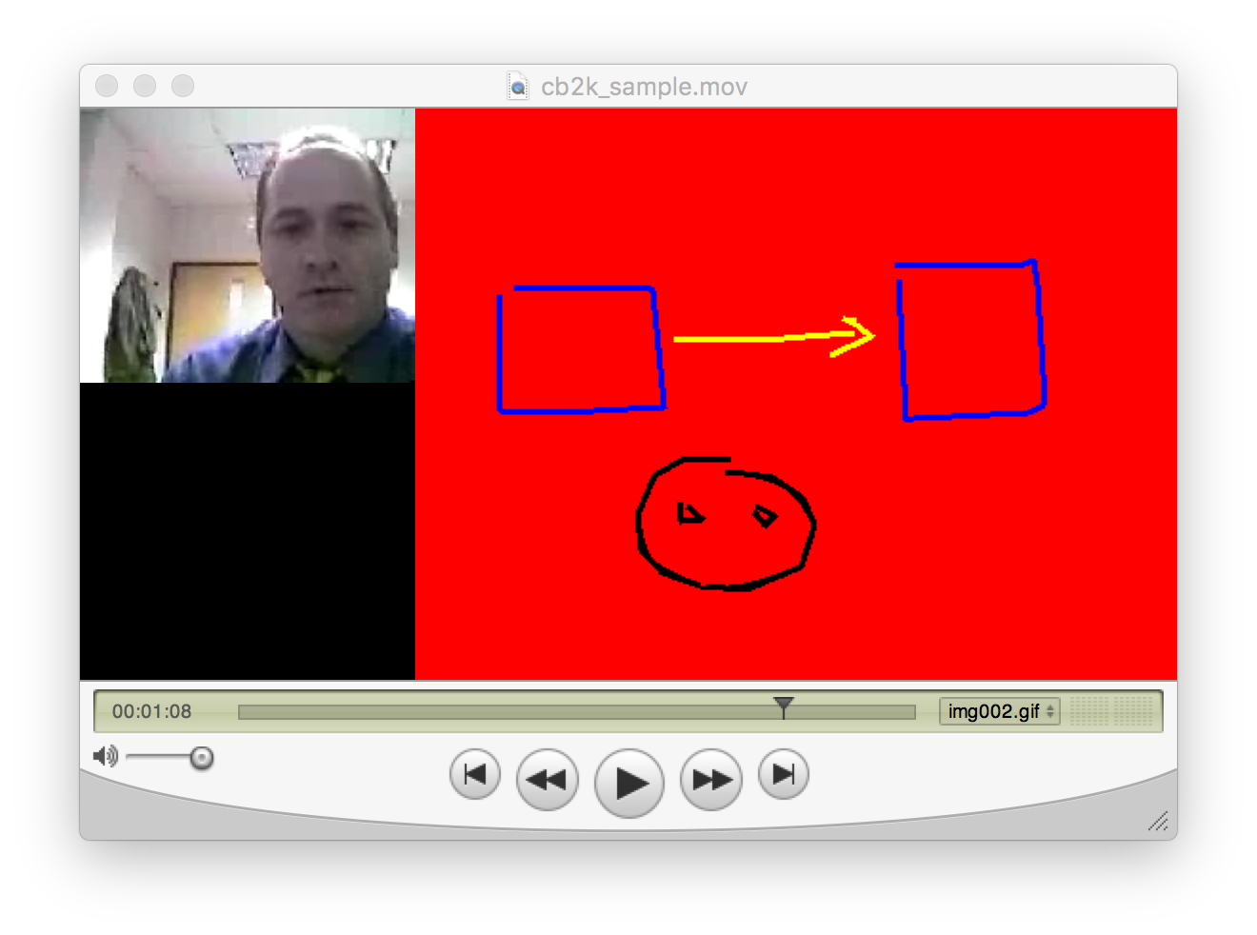
Clipboard-2000

Slide 17
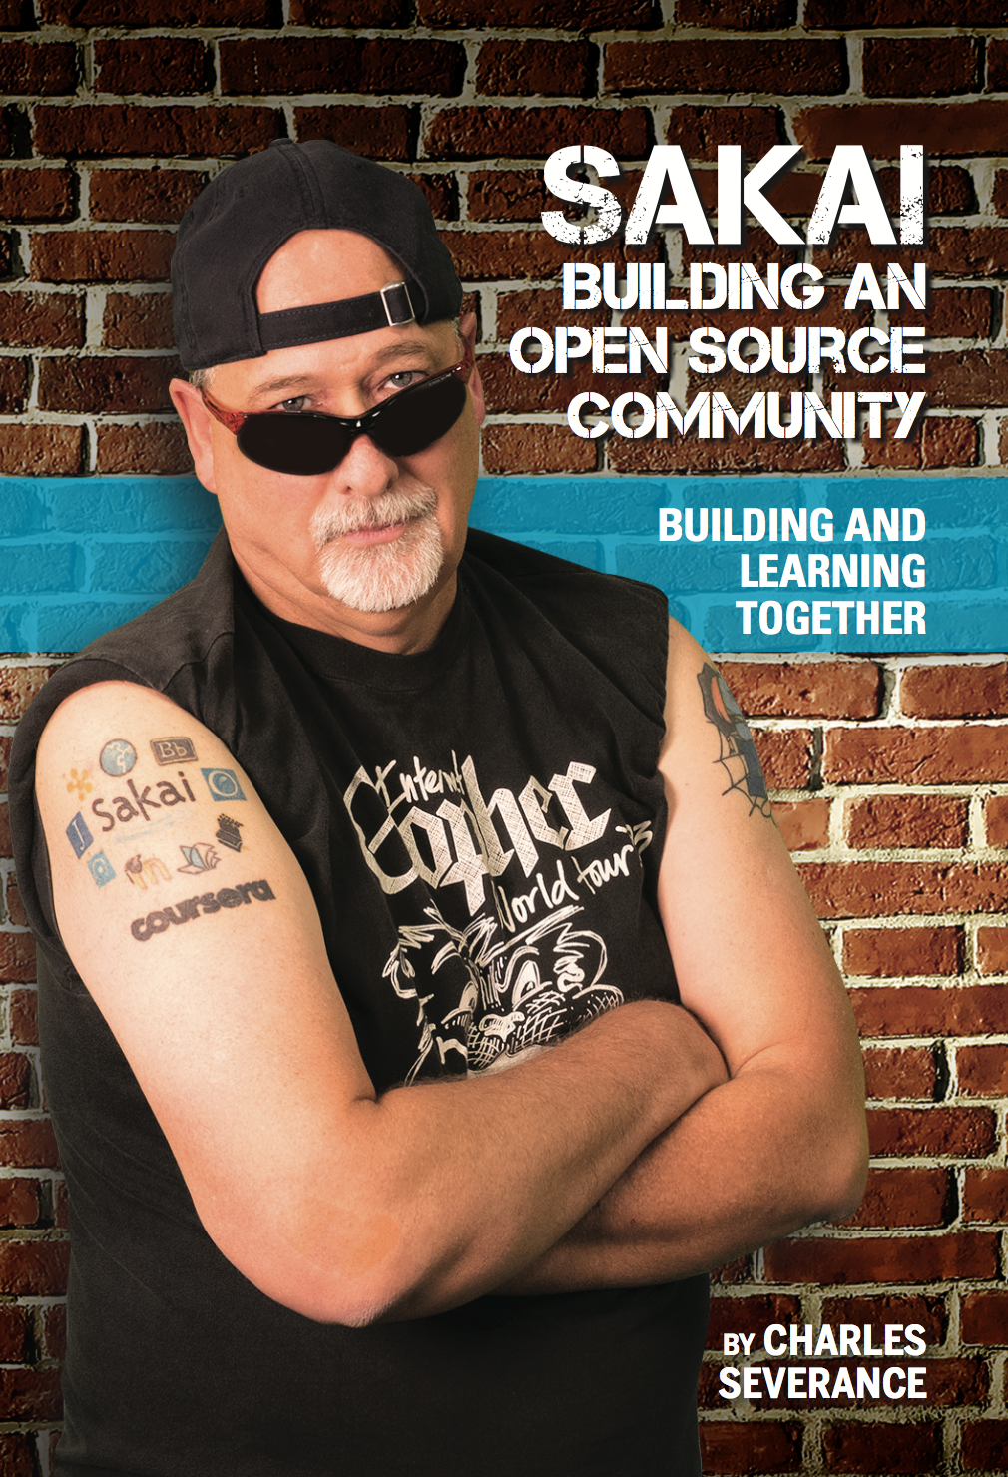
2002 - present
www.sakaiproject.org
www.dr-chuck.com/sakai-book

Slide 18
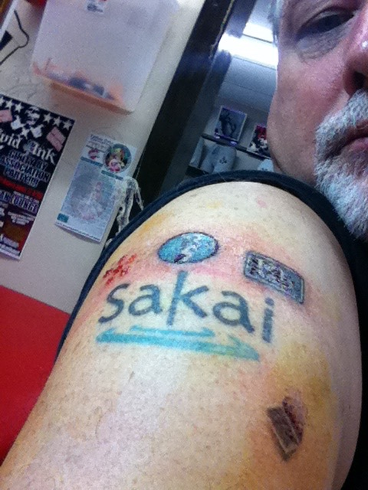
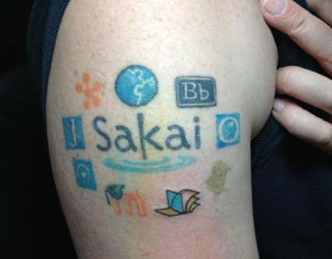
IMS Learning Tools
Interoperability (LTI)
2008-2013

Slide 19

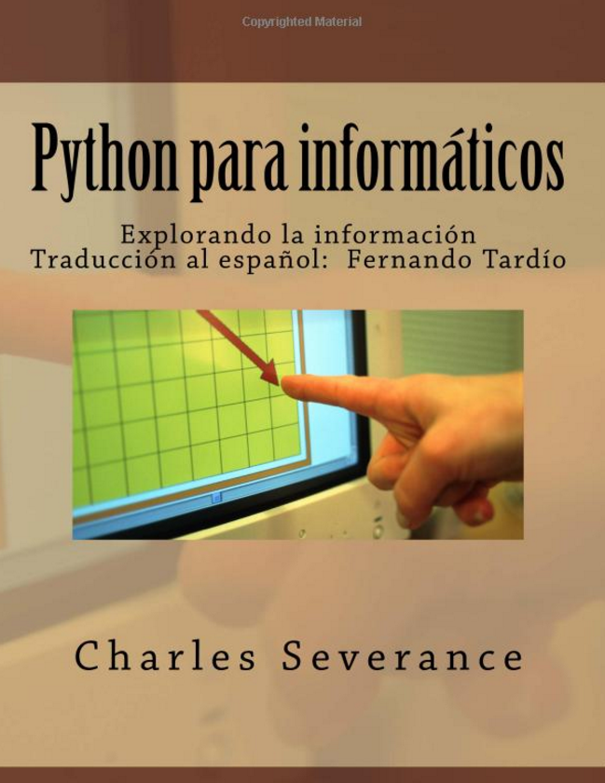
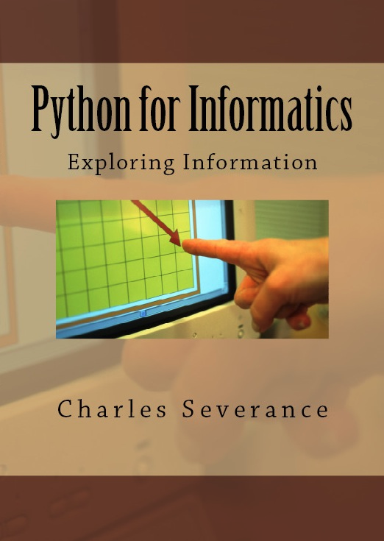
2008 - present

Slide 20
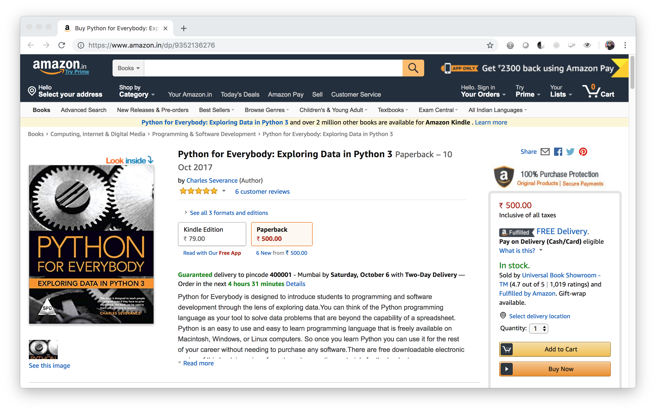

Slide 21
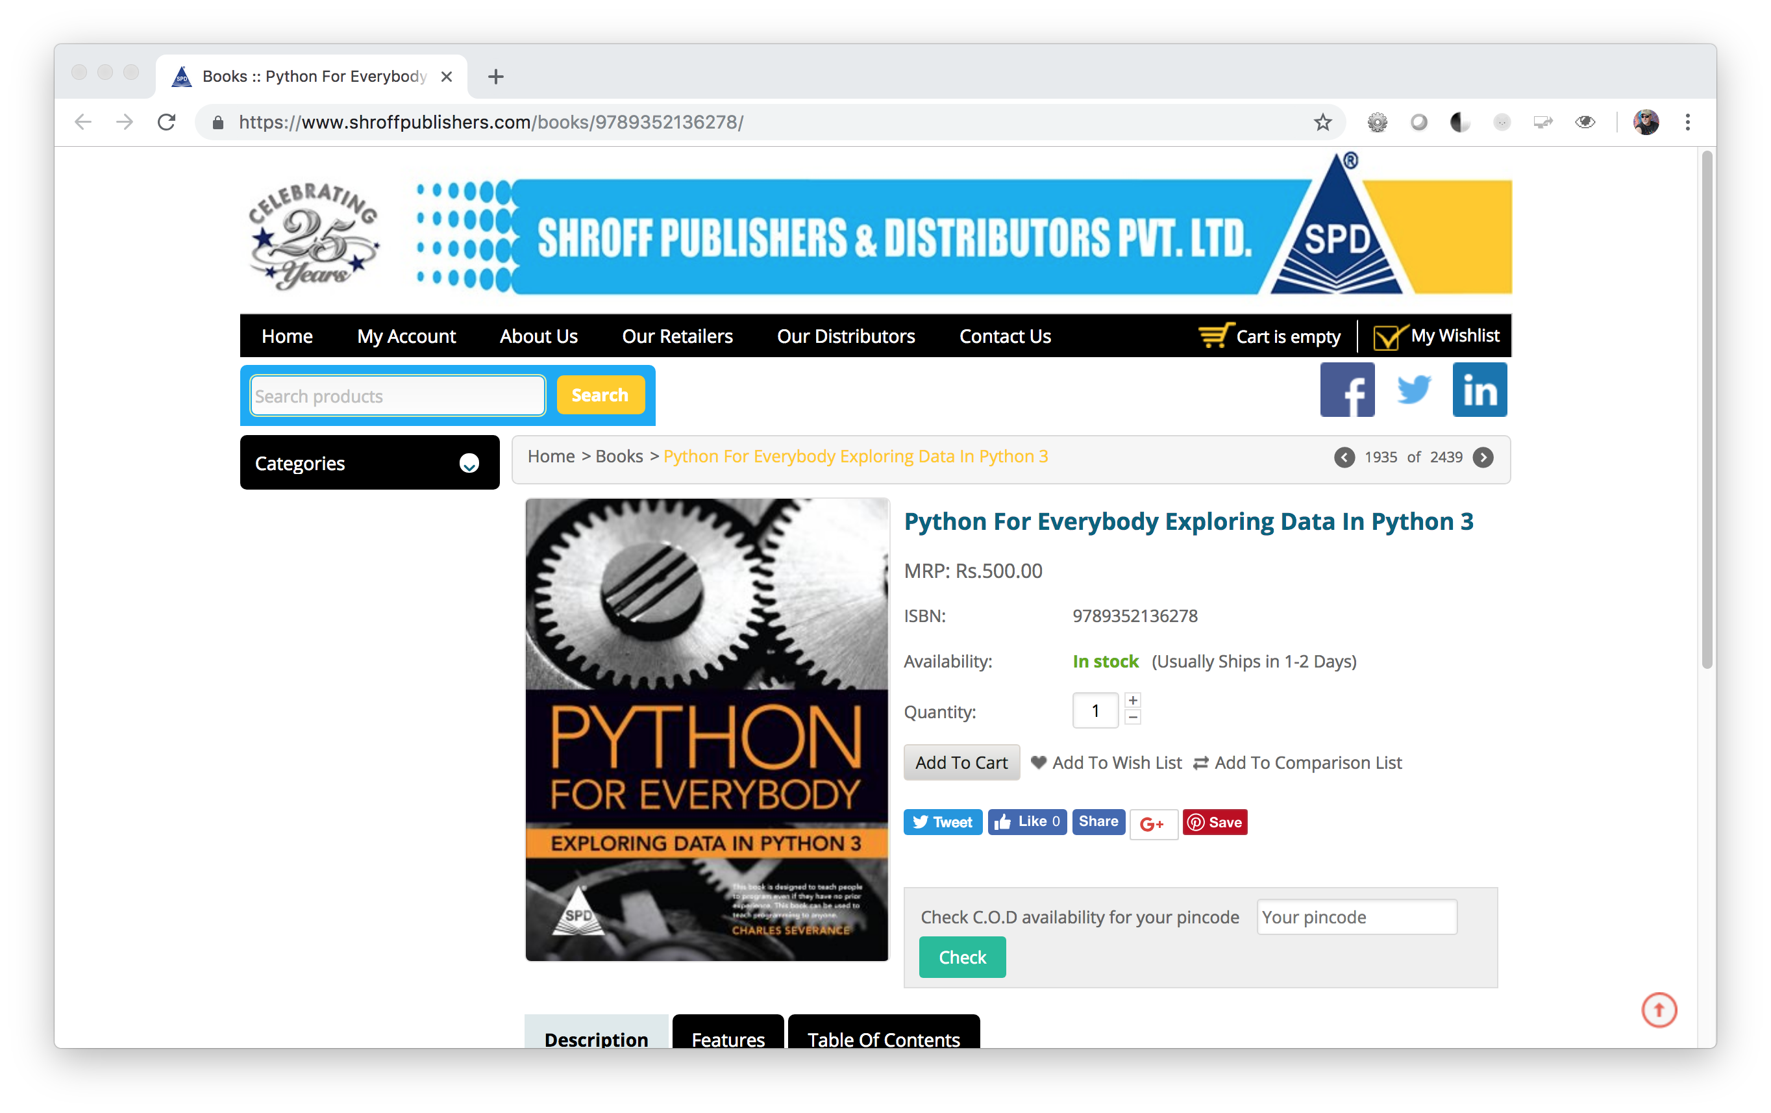

Slide 22
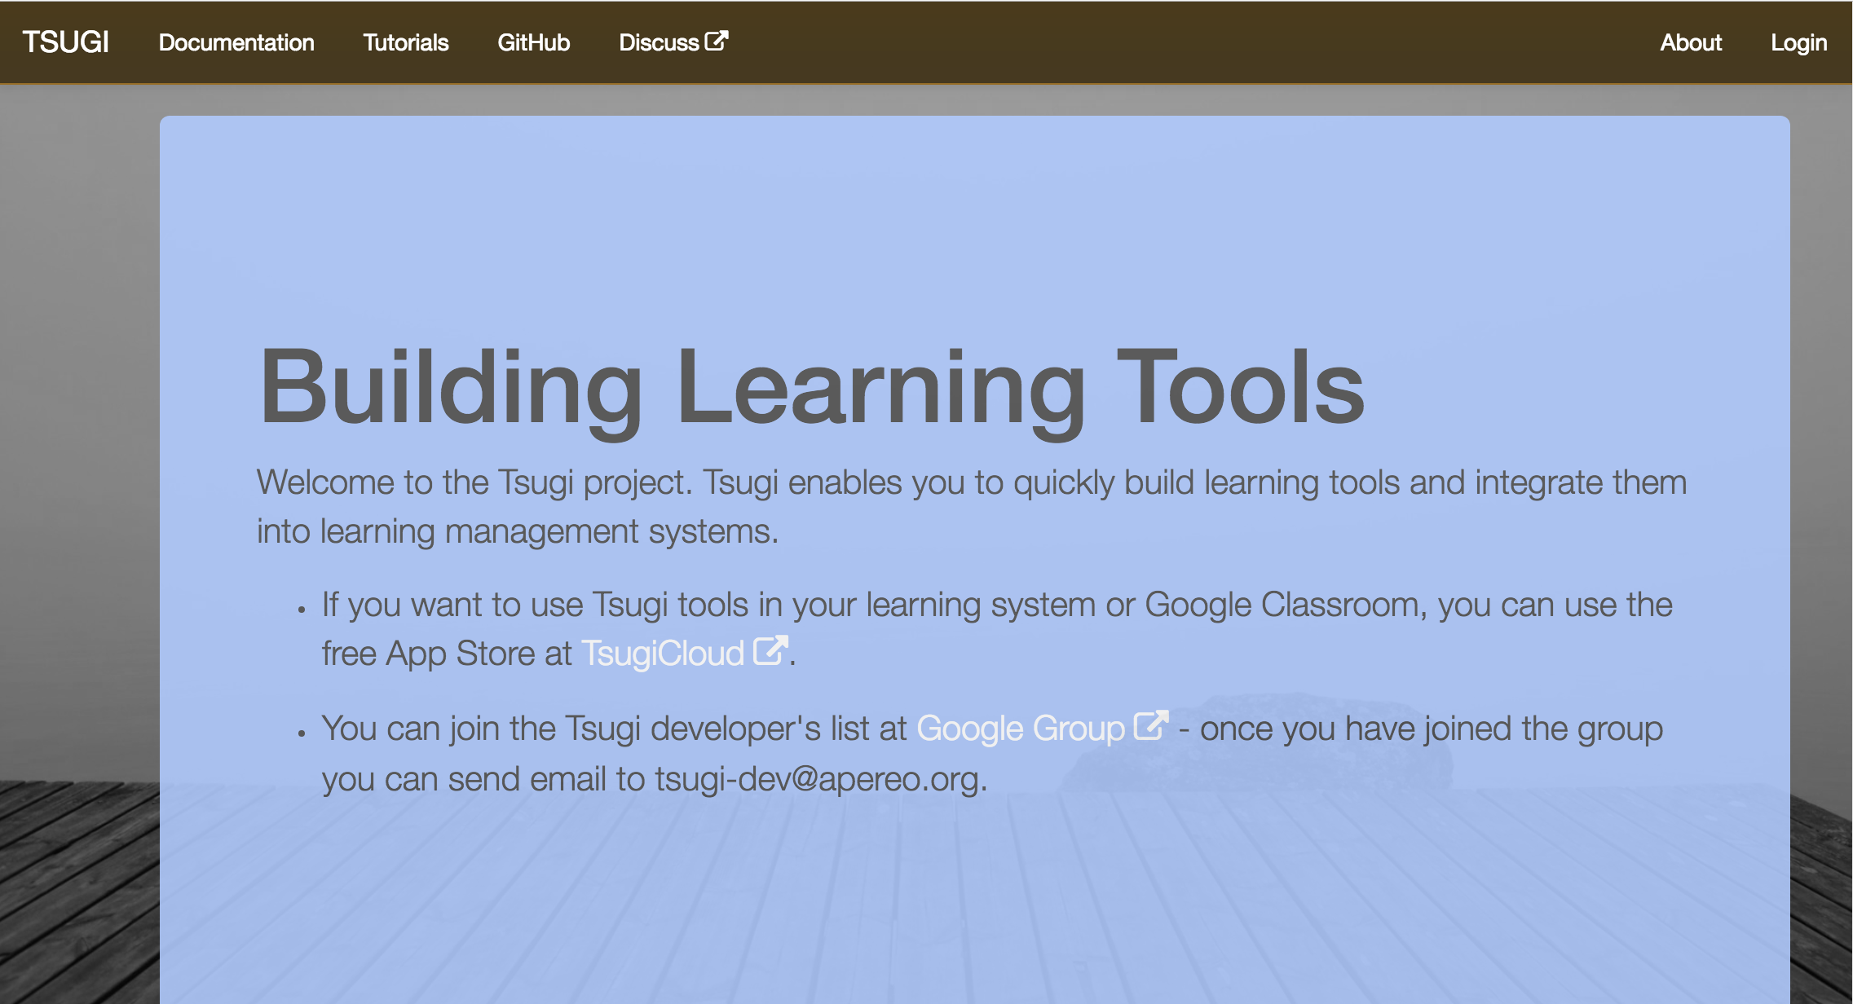
2013 - Present

Slide 23
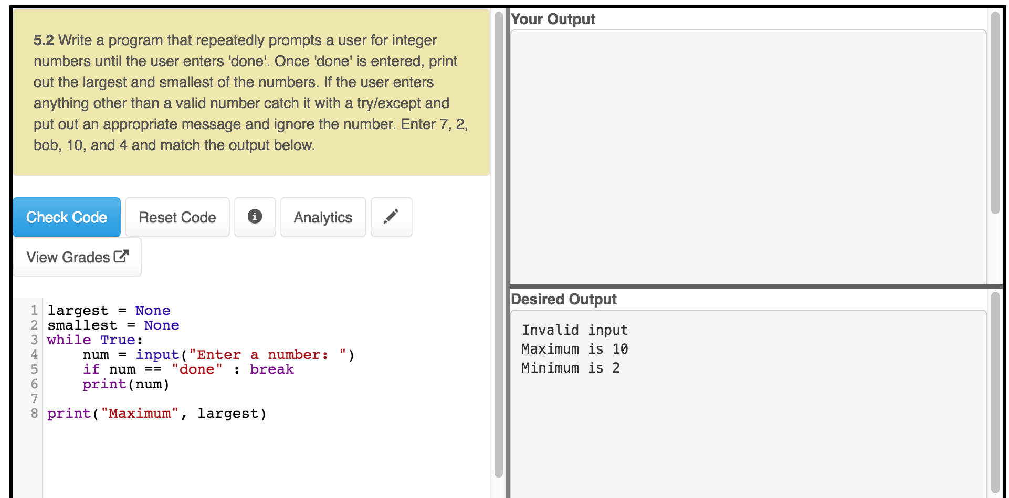
www.py4e.com

Slide 24
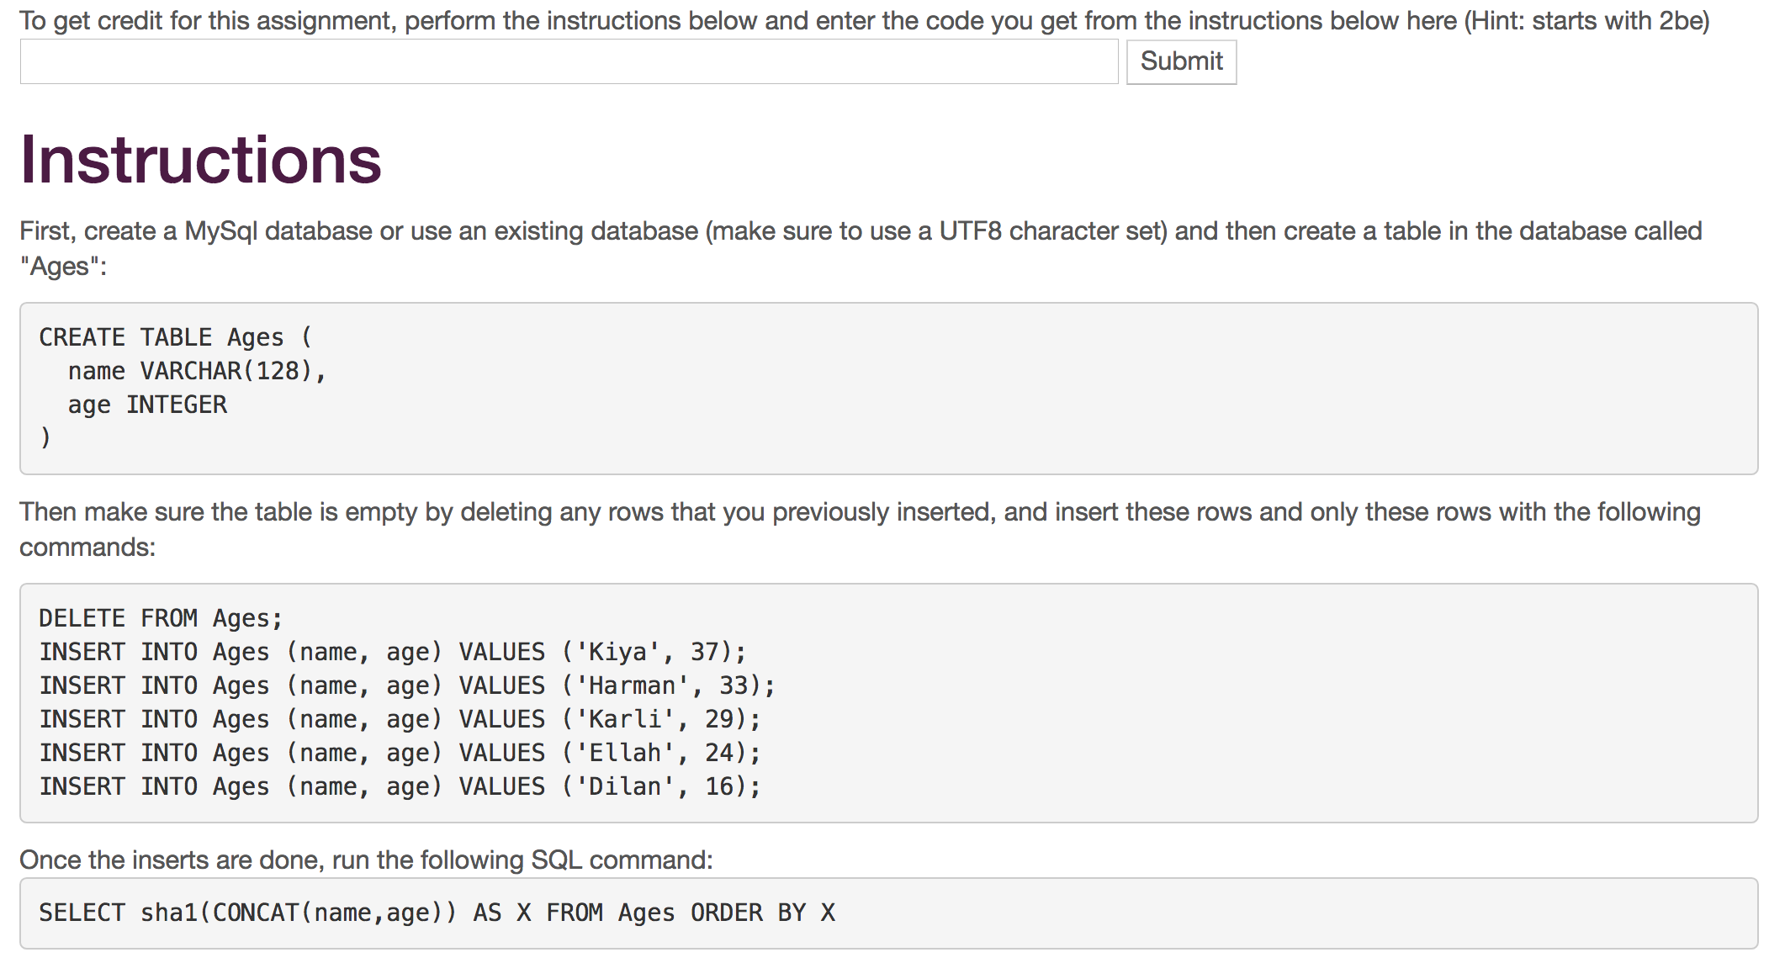
www.wa4e.com

Slide 25
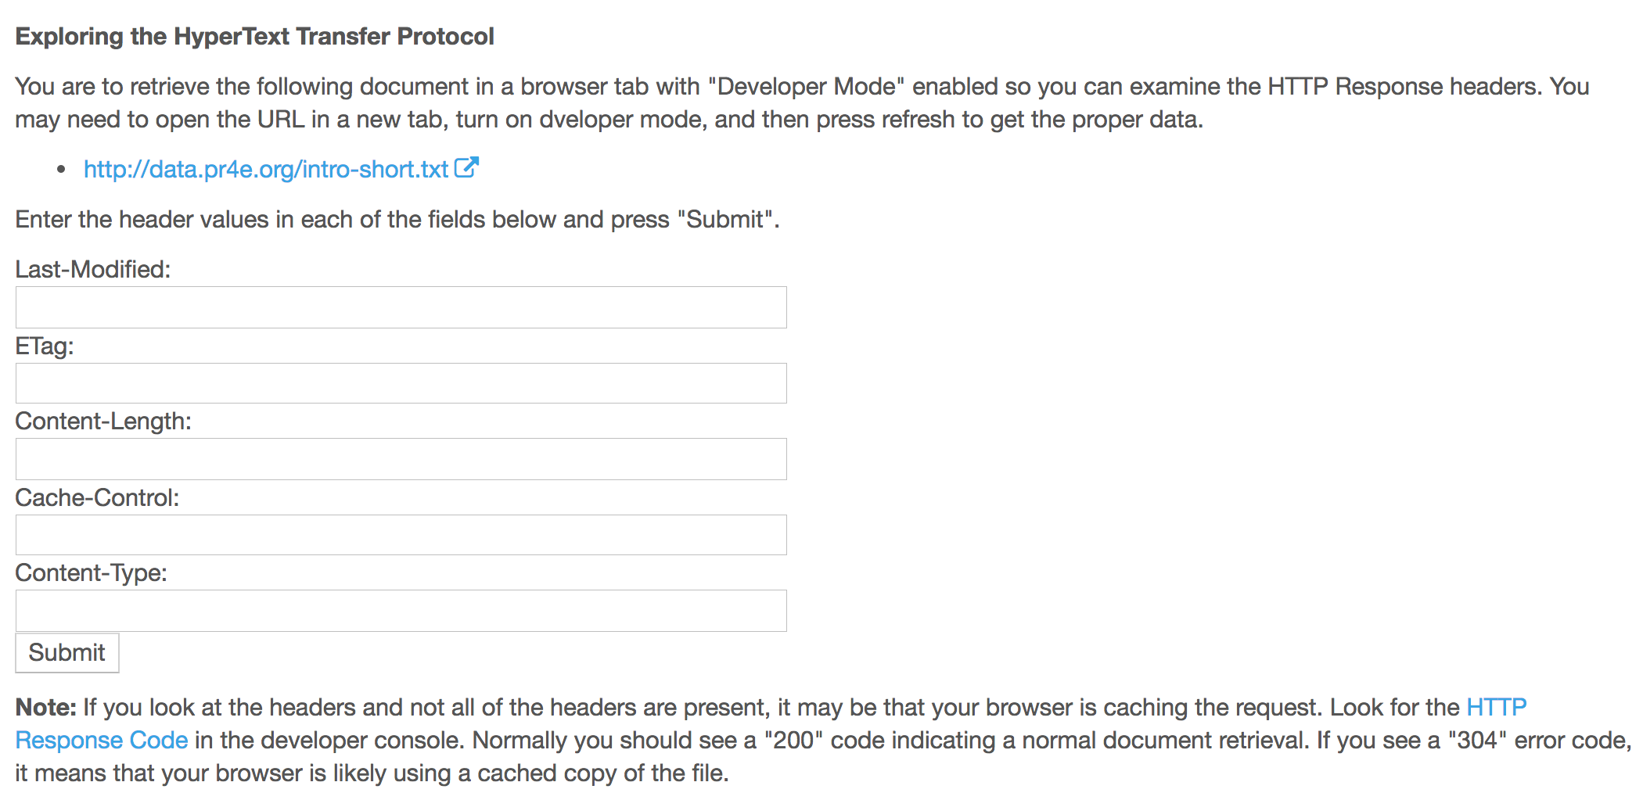
www.wa4e.com

Slide 26
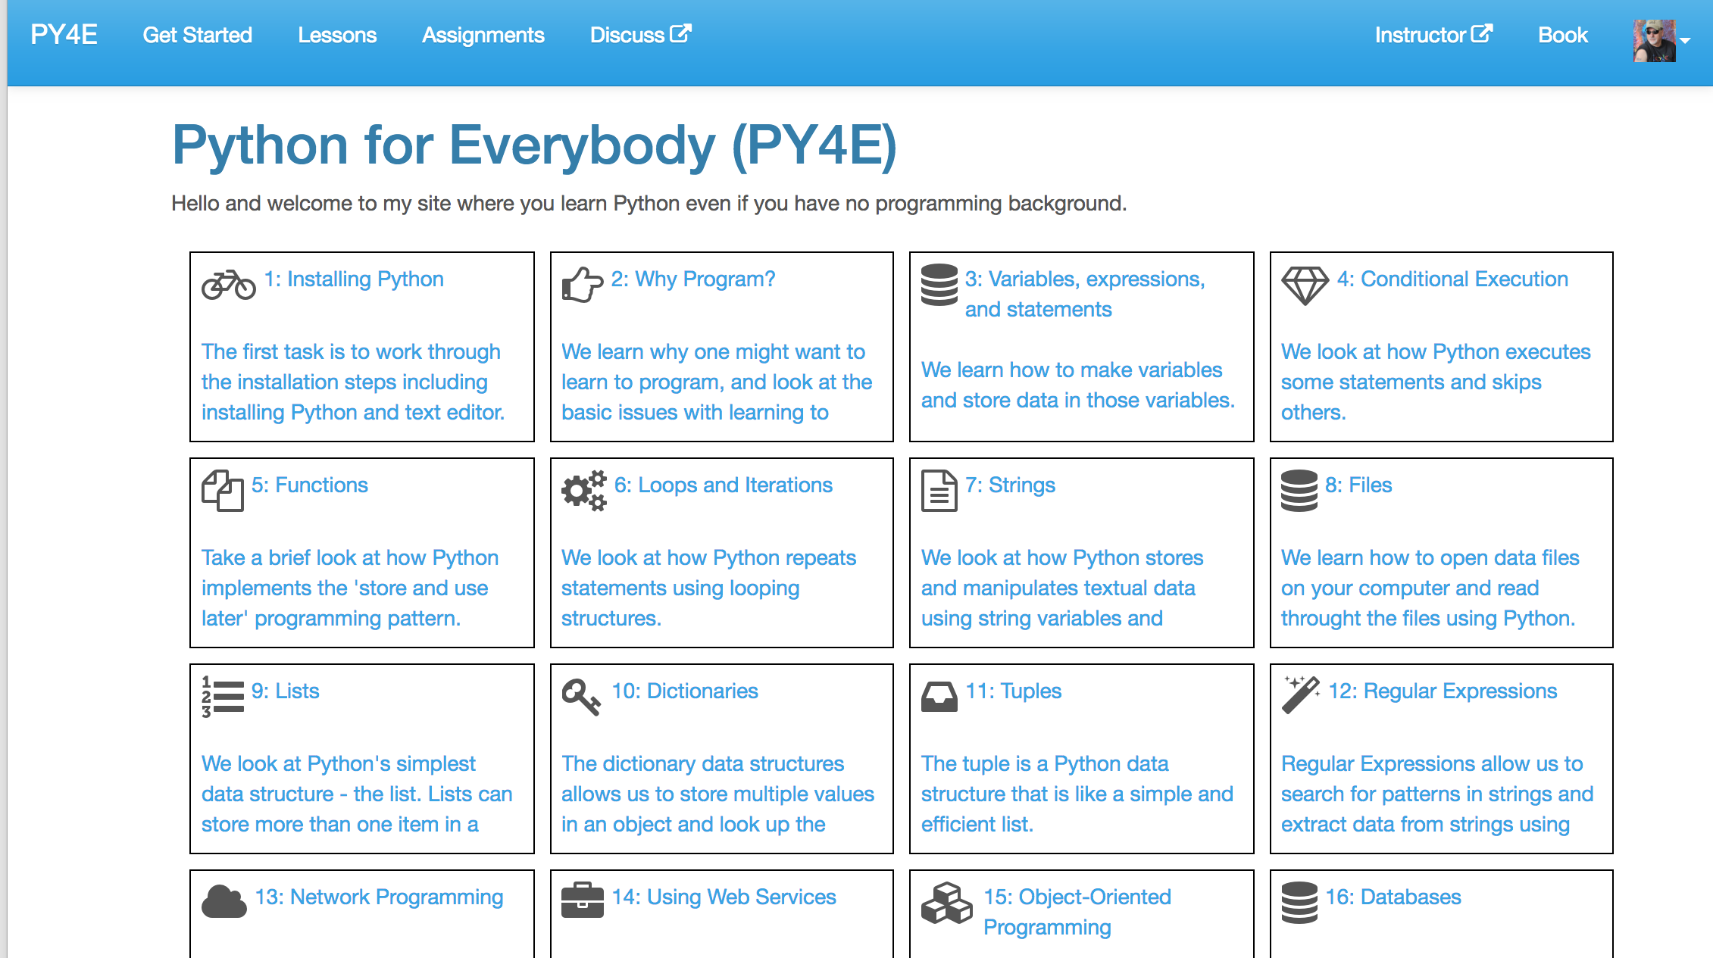
www.py4e.com

Slide 27
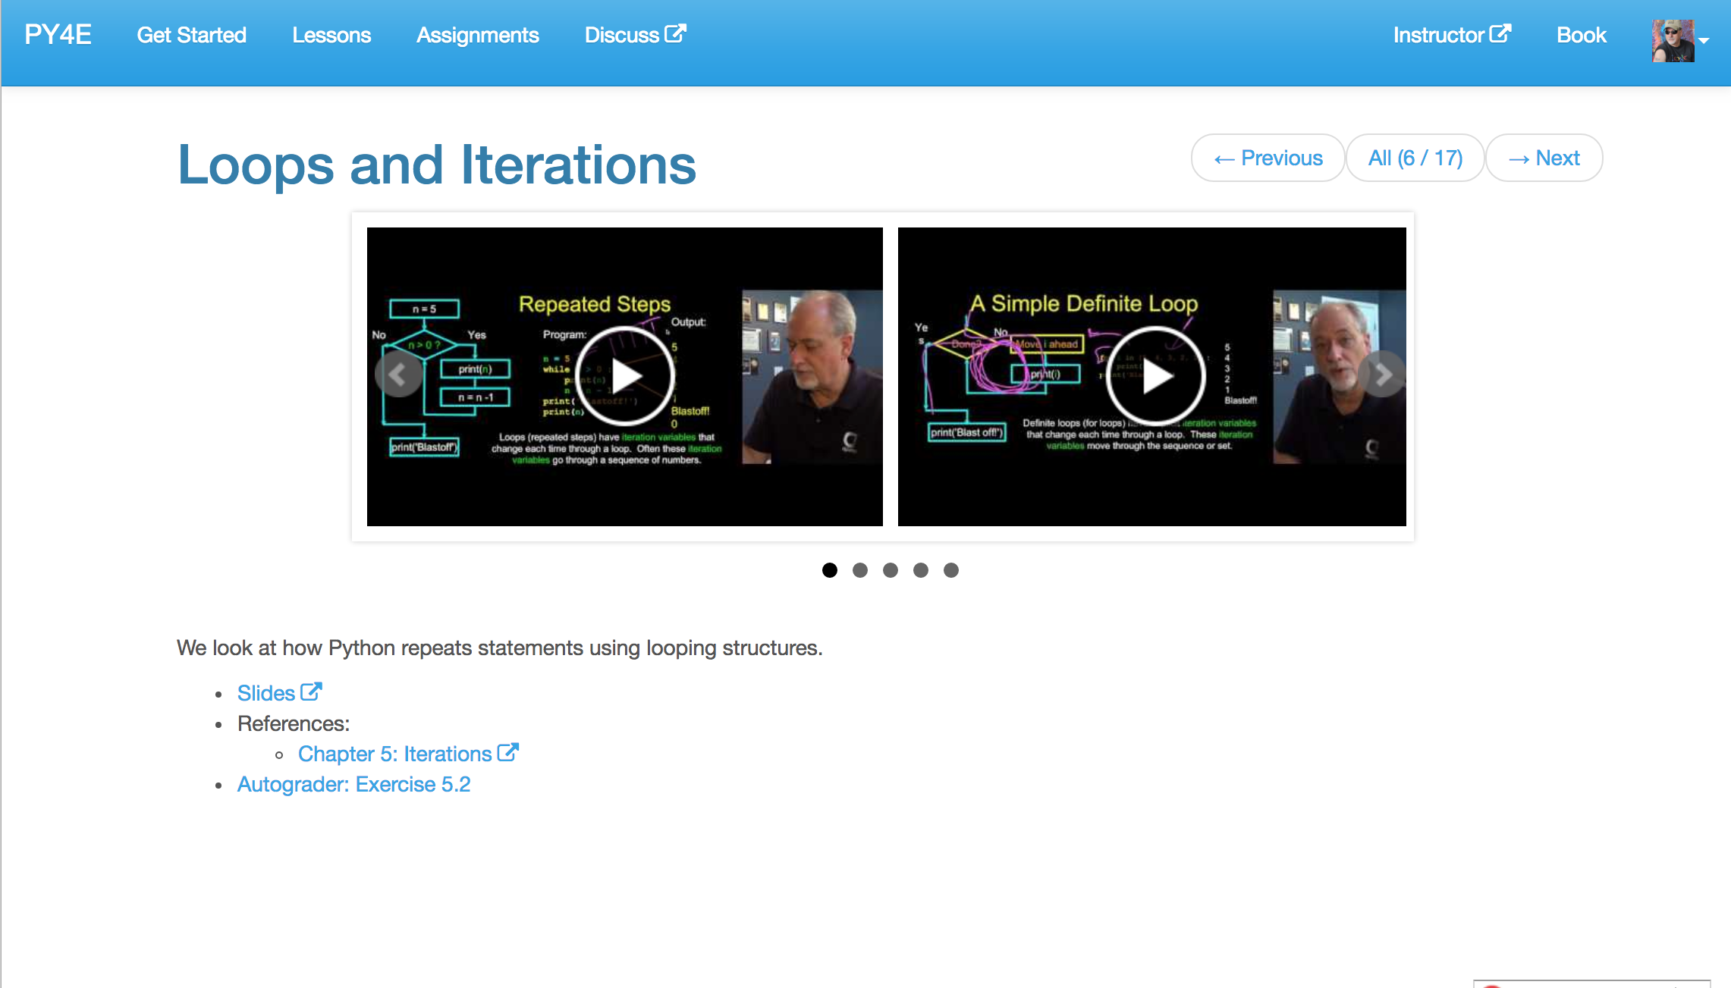
www.py4e.com

Slide 28
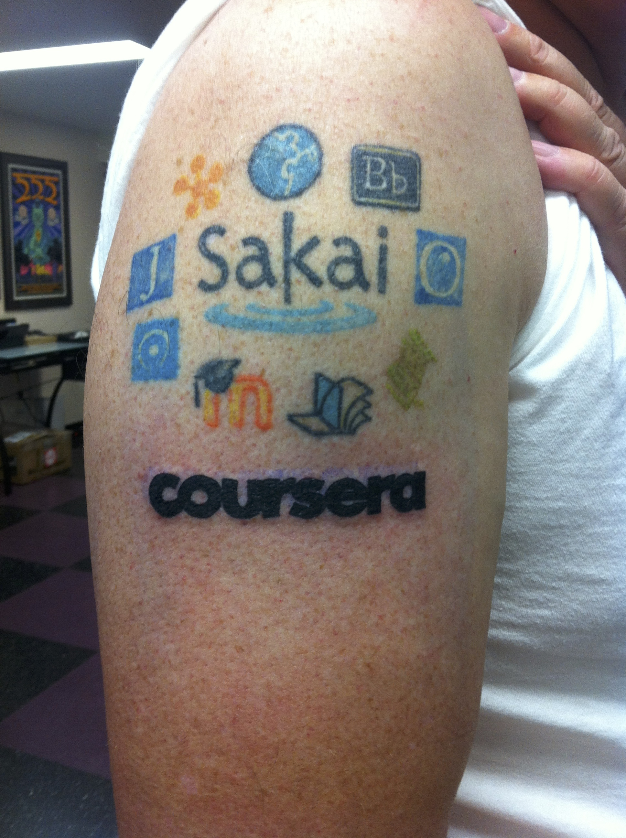
November 2013, I spent two days at Coursera in Mountain View and help them code Learning Tools Interoperability into the product.
That same night, in Redwood City, I added Coursera to my Tattoo.

Slide 29
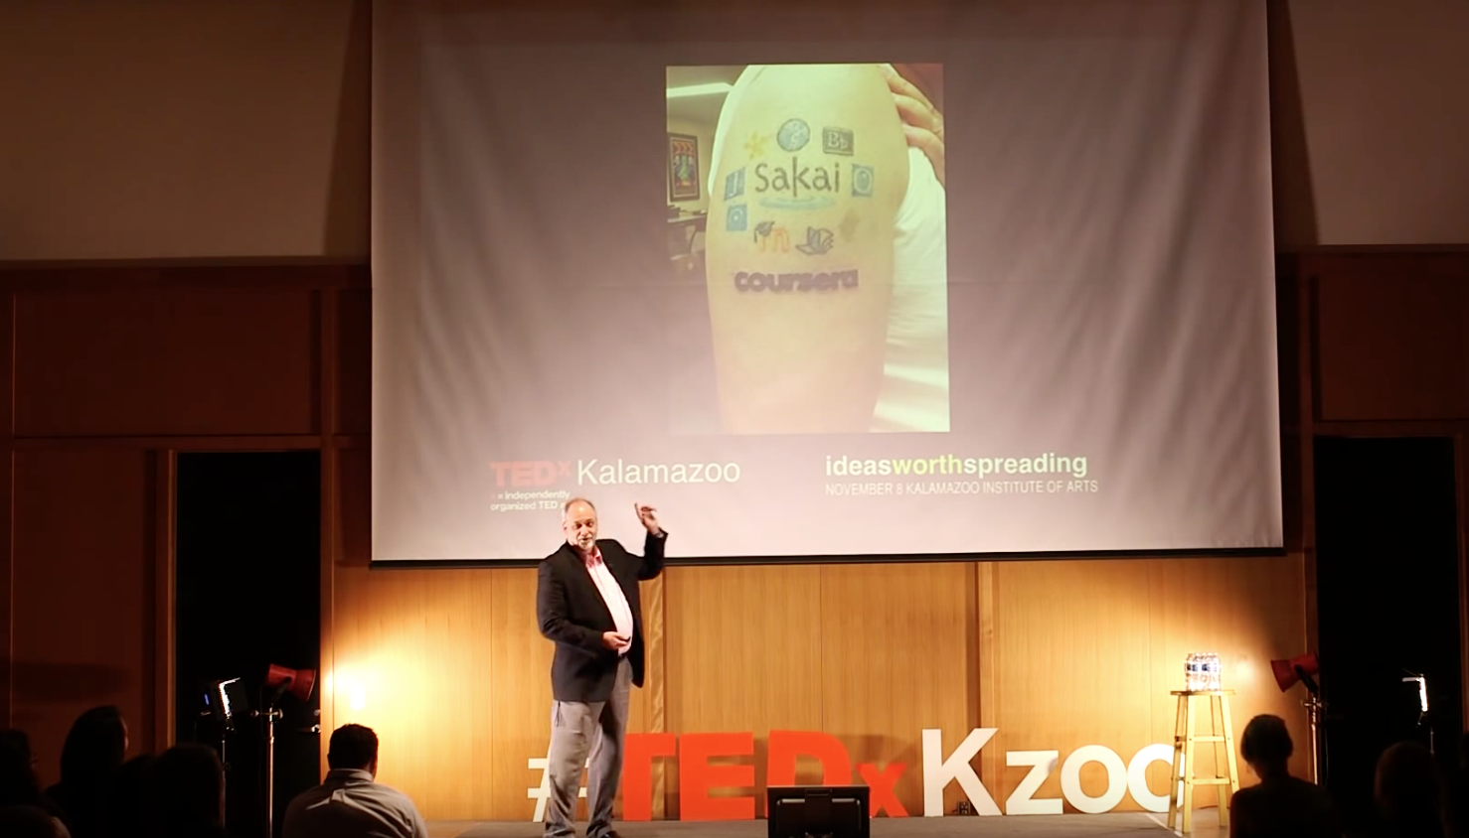
I fly back to Michigan the next day and give a TEDx talk in Kalamazoo.
https://www.youtube.com/watch?v=slscHD40r78

Slide 30
Building Coursera Courses So Far…
Specializations
Python for Everybody (2015)
Web Applications for Everybody (SQL / PHP / JavaScript) (2017)
Courses
Internet History, Technology, and Security (2012)
Python (5)
Web Applications (4)
Teachout (www.teachout.org)
Internet and You with Doug van Houweling (2017)

Slide 31
Not just Technology…

Slide 32
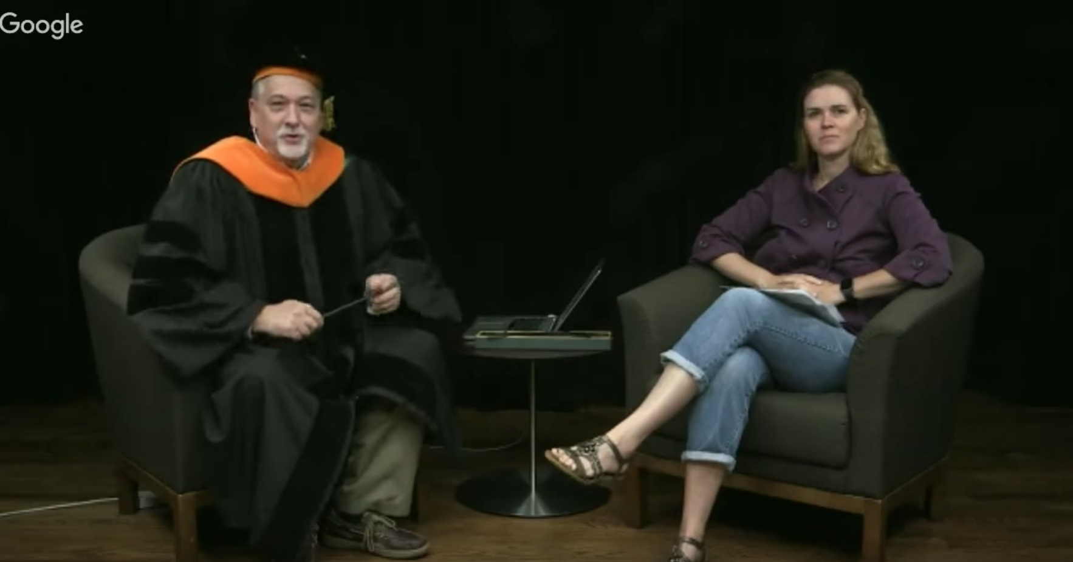
https://www.youtube.com/watch?v=T5N7yxKFn9g

Slide 33
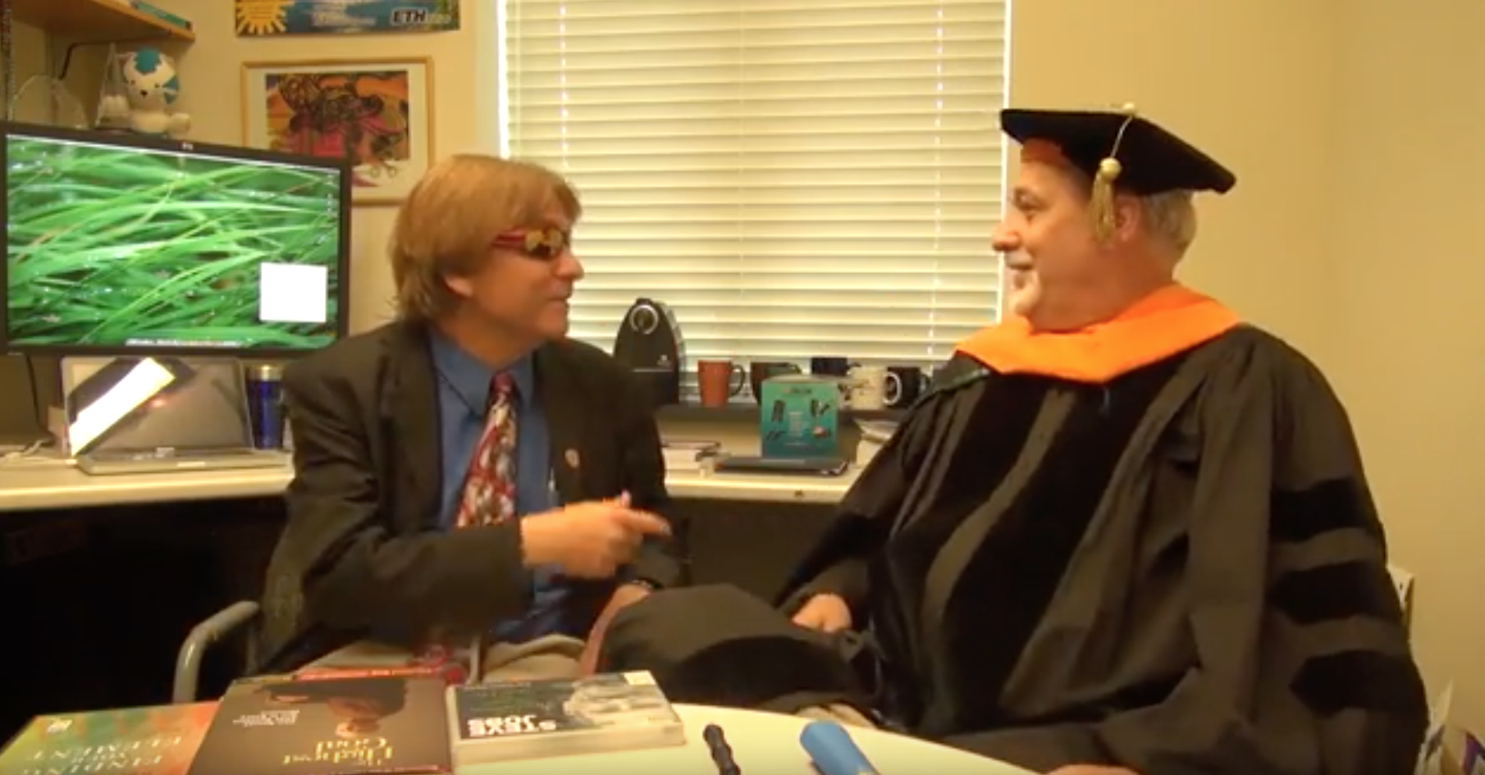
https://www.youtube.com/watch?v=SfQYA0JQWkA

Slide 34
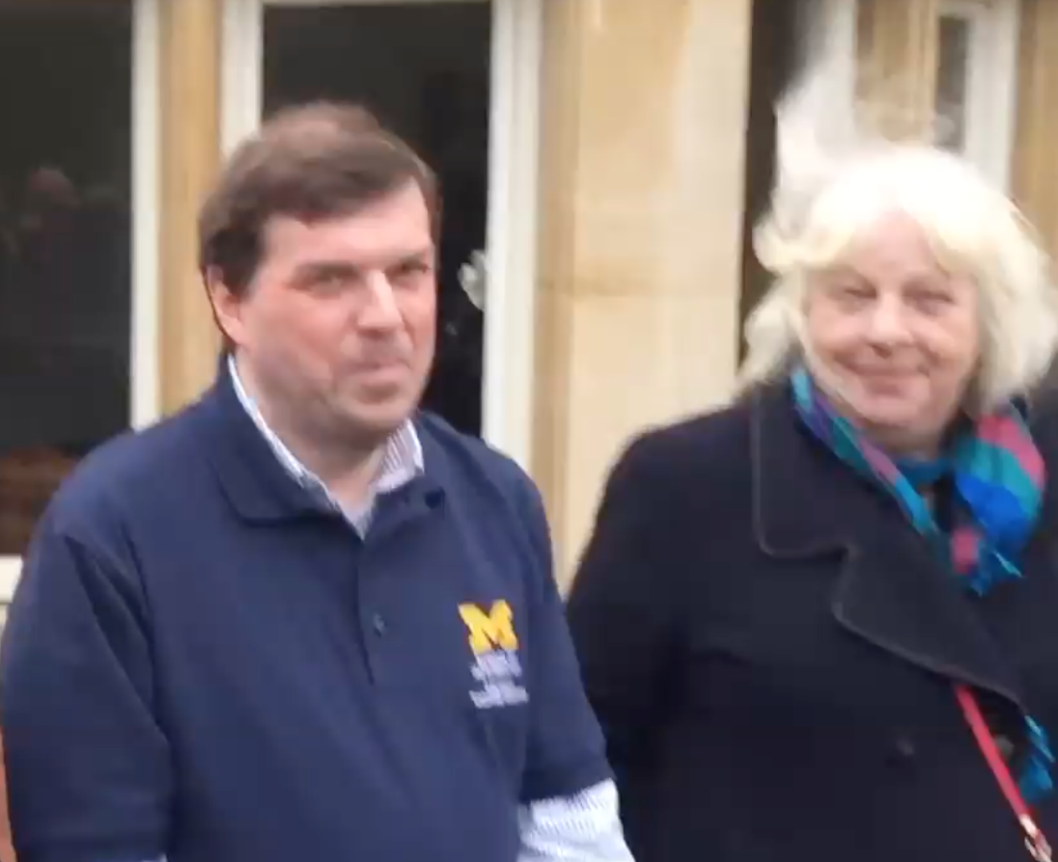
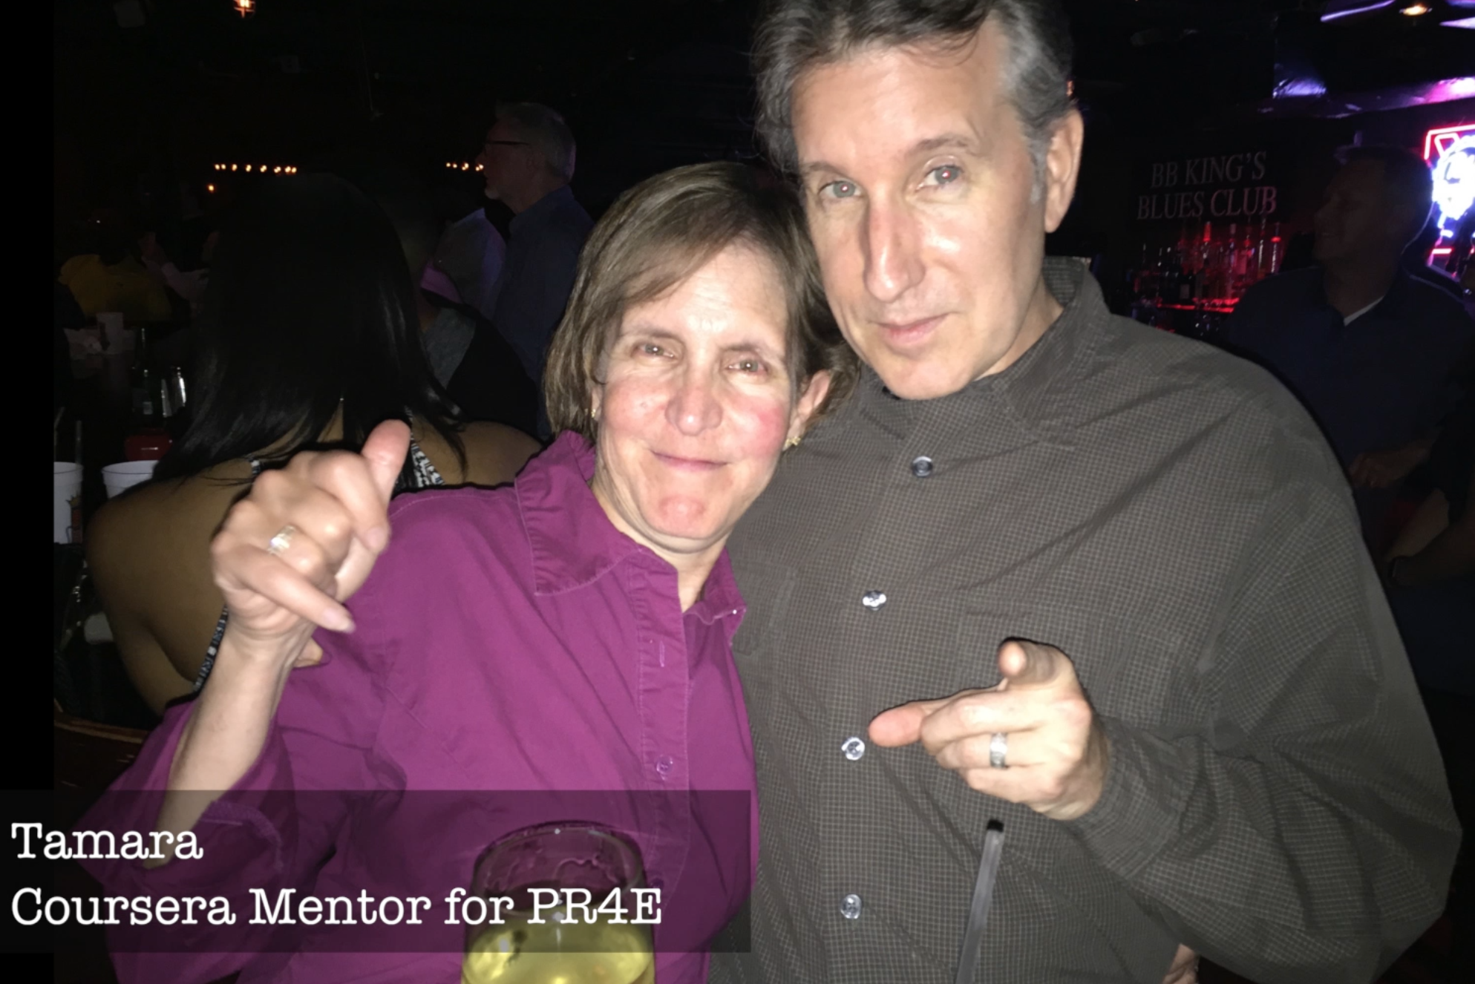
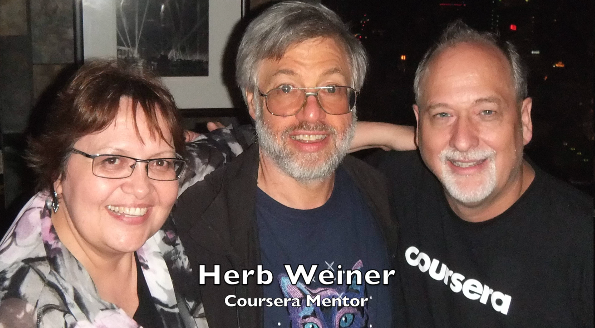
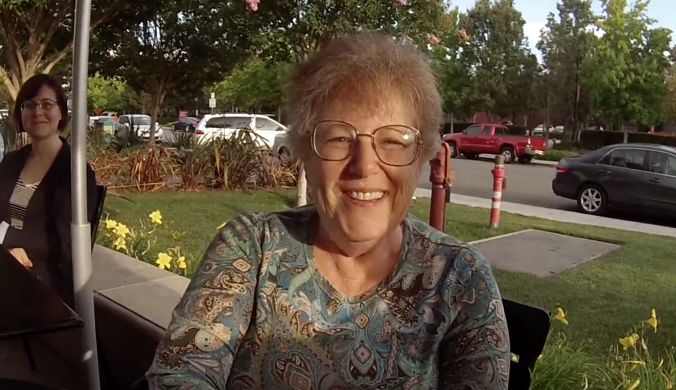
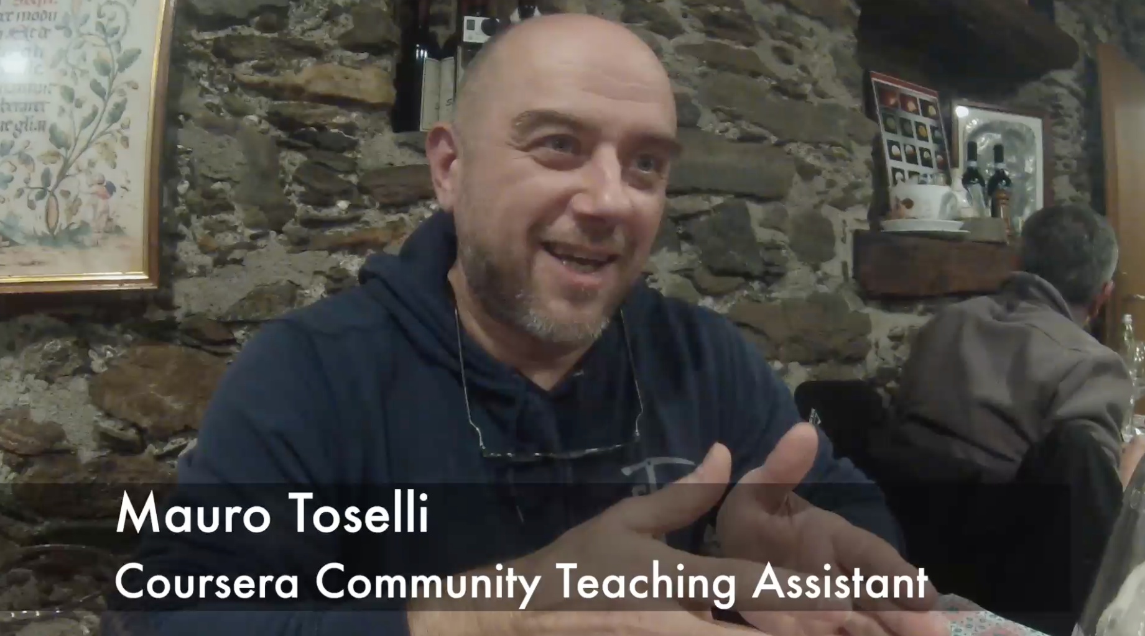

Slide 35
New York, Los Angeles, Ann Arbor, Chicago, Washington DC, Memphis, Seattle, Seoul, Barcelona, London, Mexico City, Amsterdam, Manila Melbourne, Perth...
http://office-hours.dr-chuck.com
Notes:
Since I have a very active travel schedule, I decided to hold office hours in the major cities I have visited. I have held office hours in over 40cities and in each location somewhere between two and 15 students show up.

Slide 36
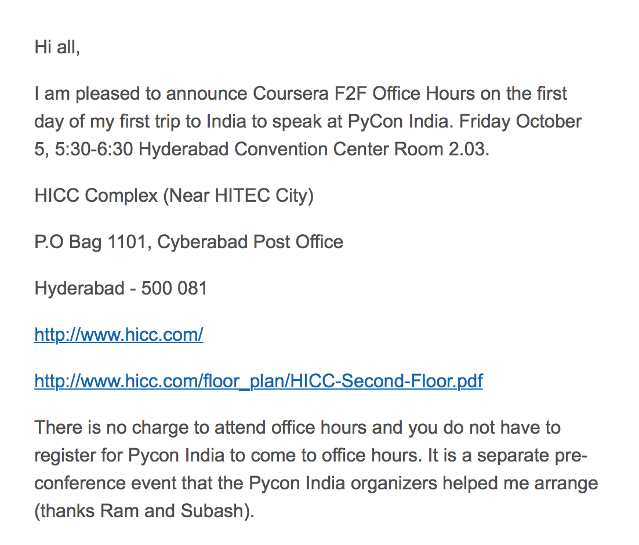

Slide 37
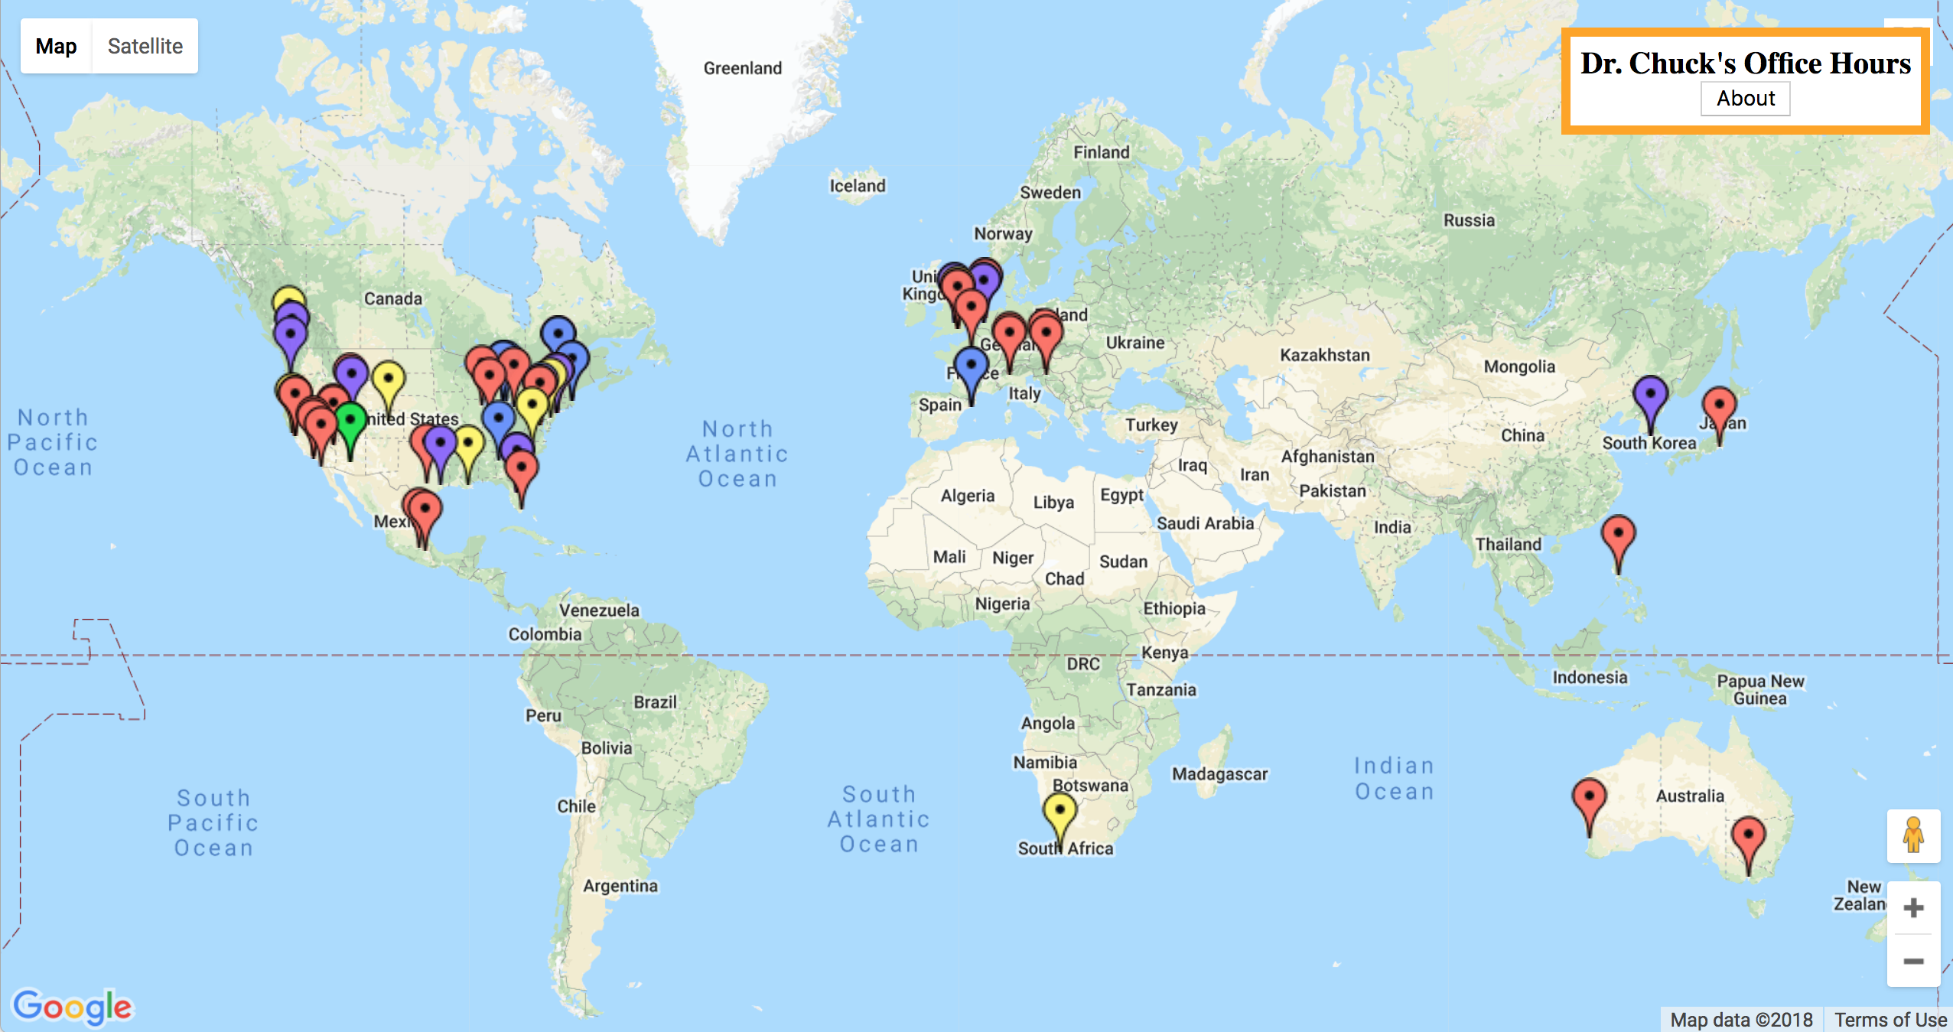
www.dr-chuck.com/office

Slide 38
Roadmap
Research: Create the first standards based application store for education
www.tsugi.org
www.tsugicloud.org
www.learnxp.com
Teaching: Build More Coursera Specializations (with 100% OER materials)
Django for Everybody
Computer Architecture for Everybody
C Programming for Everybody

Slide 39
Questions / URLs…
EdTech Tools
www.tsugi.org
www.tsugicloud.org
www.learnxp.com
Coursera MOOCs
Python for Everybody
Web Design for Everybody (Colleen)
Web Applications for Everybody
Free MOOCs / CC Materials
www.wa4e.com
www.py4e.com
www.wd4e.com (Colleen van Lent)
Twitter: @drchuck

